Slide 1
World History
Unit 2

Slide 2
Structure of Governments
Tyrannical
Leader/Monarchy
Military leader
Warriors
Peasants/Workers
Mostly found in China region
Non religious

Slide 3
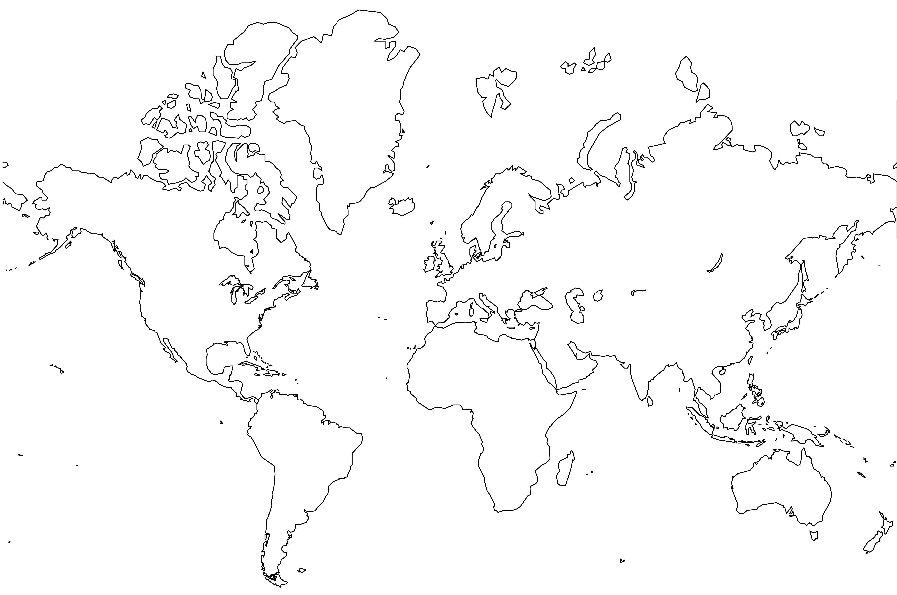

Slide 4
Structure of Governments
Theocracy
God or gods
God-King
Priest
Military
Peasants
“Middle East” area
Religious

Slide 6
Structure of Governments
Democracy
People
Citizens
Leaders
Many religions mixed

Slide 8
Nomads and Migrations
Nomads – wandering groups
Migration – moving from one place to another to live.
Still existed
Not everyone lived in a civilization

Slide 9
Three major migration groups
Phoenicians 2000 BC
Israelites 2000 BC
Aryans 1500 BC
Sea Peoples ???2000 BC

Slide 10
Phoenicians
Location
Throughout the Mediterranean Sea area
Lasting Impact
Simplified Cuneiform writing into 22 character alphabet

Slide 11
Israelites
Location
Mesopotamia to Canaan to Egypt to Canaan
Lasting Impact
Monotheistic – belief in one God

Slide 12
Aryans
Location
Europe
Lasting Impact
Caste system
Complex social structure
Basis for Hinduism

Slide 13
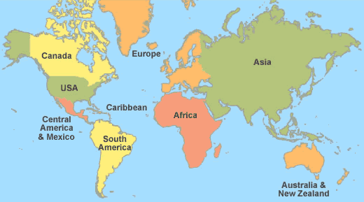
Aryans
Phoenicians
Israelites

Slide 14
Beliefs in Ancient World Clash
Polytheism – many gods
Egypt
Mesopotamia
Monotheism – one God
Israel

Slide 15
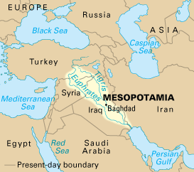

Slide 16
Clash Between Beliefs “Prince of Egypt”

Slide 17
Classical Civilizations
1000 BC – 600 AD

Slide 18
Classical Era
Period of the rise of several large civilizations that grew from earlier ones
Classical differ from River Valley in these ways:
Kept better records – know more about them
Provide direct links to today’s world – root civilizations
Expansionist –conquered other, lands much larger

Slide 19
Four areas of Classical Civ’s
The Mediterranean
Greeks
Romans
China
Zhou
Han
India
Mauryan
Gupta
South America
Inca
Mayan
Aztec

Slide 20
Characteristics of Classical Civ’s
Patriarchal family structure – male authority
Agricultural based economies
Complex governments
Expanded trade base – land and sea

Slide 21
India China Greece & Rome

Slide 22
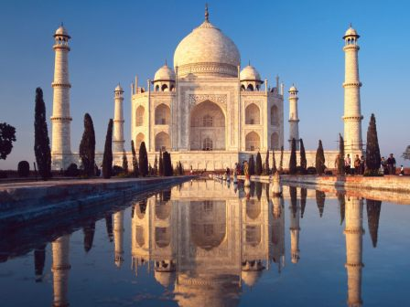
India
3000 B.C. – A.D. 500

Slide 23
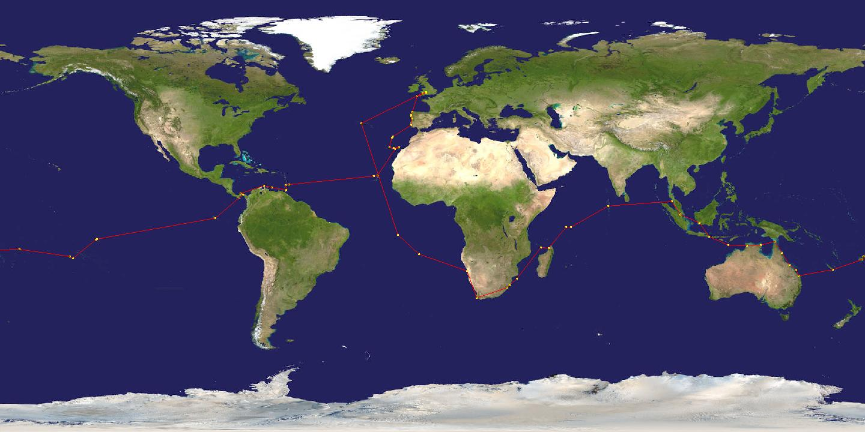

Slide 24
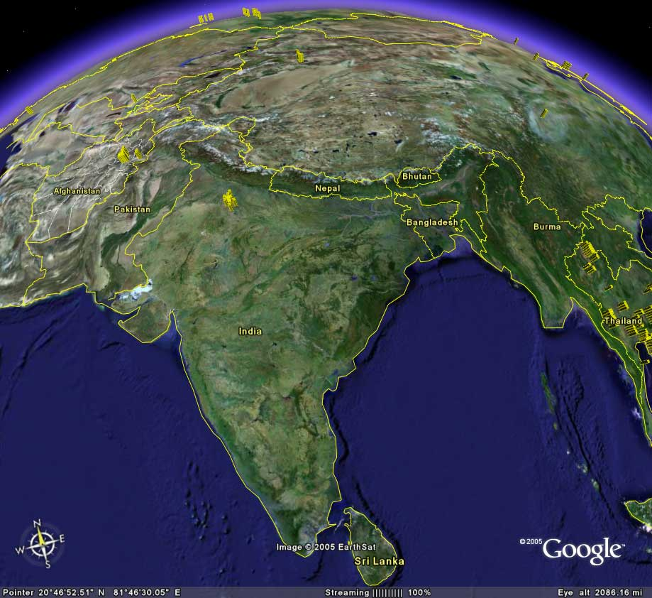

Slide 25
Early Civilizations in India
Geography
Migration and Interaction
Religions of India

Slide 26
Geography
Mountains
Himalayas
Highest in the world
Rivers
Ganges
Indus
Monsoons
Seasonal wind pattern that brings rain

Slide 27
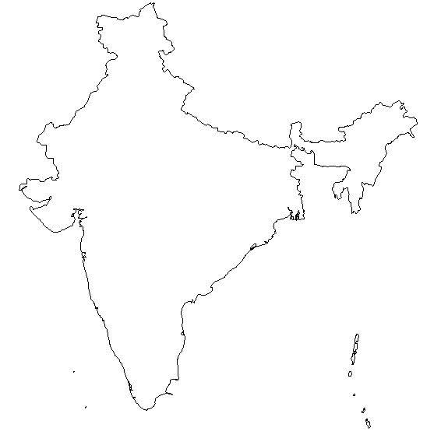

Slide 29
Aryans from Europe

Slide 30
Migration and Interaction
Aryans arrive in 2000 B.C.
Nomadic people from Europe
Bring the “Caste System” with them

Slide 31
Social classes
Four Varnas – social groups that ranked people from high to low
Brahmins (top class, religious leaders)
Kshatriyas (warriors)
Vaisyas (commoners, merchants, farmers)
Sudras (peasants, servants)

Slide 32
Varnas | Jobs | Body Parts | Functions
Brahmins | Priests, teachers | Mouth | Teach, advise
Kshatriyas | Warriors, police | Arms | Defend, protect
Vaisyas | Merchants, farmers | Legs | Supply needs
Sudras | Peasants, servants | Feet | Support society

Slide 33
Religions of India
Hinduism
Buddhism

Slide 34
Hinduism
Founder
Unknown origin

Slide 35
Hinduism
Beliefs
One force in the universe
Ultimate reality or “god” – called Brahman
Each individual (atman) should seek to know this ultimate reality
Merging self and Brahman after death
How to merge?
Yoga

Slide 36
“When all the senses are stilled, when the mind is at rest, that, say the wise, is the highest state.”

Slide 37
Hinduism
Gods
Brahma – creator
Vishnu – preserver
Shiva – Destroyer

Slide 38
Hinduism
Teachings/Principles
Reincarnation – soul is reborn in different form after death.
Karma – force generated by peoples actions
Existence is no accident it is a result of past behavior.
Do good improve status in next life
Dharma – divine law
people do their duty
According to status

Slide 39
Buddhism
Founder
Siddhartha Gautama
Known as Buddha or “Enlightened One”
His background
Born in Himalayas
Rich family
Married a princess
29 yrs old looked at suffering

Slide 40
‘Would that sickness, age, and death might be forever bound.”

Slide 41
Siddhartha Gautama
Background continued…
Ascetic –self-denial practices
Fasting
Intense meditation
Under a tree he finds “enlightenment”
Spends rest of his life preaching and teaching what he learned.

Slide 42
“Do not go by what is handed down, nor by the authority of your traditional teachings. When you know yourselves, ‘These teachings are good or not good,’ only then accept or reject them.” ”

Slide 43
Principle of Buddhism
Denial of the material world
Bodhi or Wisdom– when you let go of the world.
Nirvana – Ultimate state of reality
End of self and great reunion with soul
Four noble truths
Eightfold Path (Middle Path)

Slide 44
Four Noble Truths
Life is suffering
Suffering is caused by our desire
End selfish desire and end suffering
How? Follow the middle path

Slide 45
Middle Path
Right:
View
Intention
Speech
Action
Livelihood
Effort
Mindfulness
Concentration

Slide 46
China

Slide 48
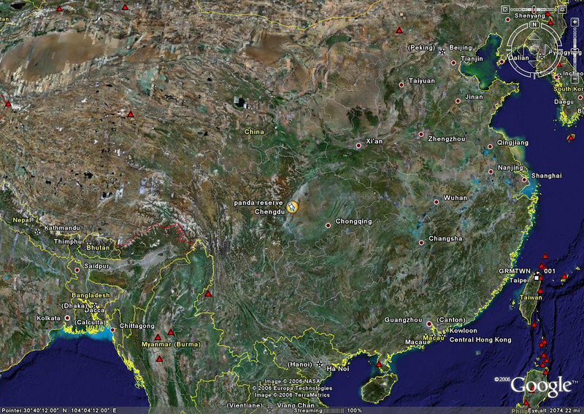
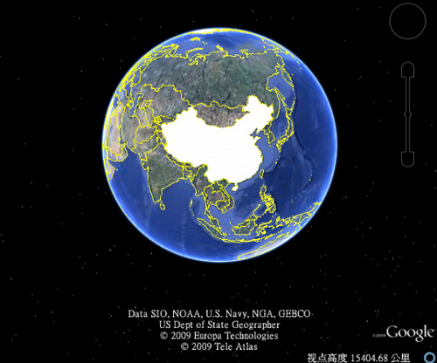

Slide 49
Early Chinese Civilizations and Dynasties
Shang
Zhou
Qin
Han

Slide 50
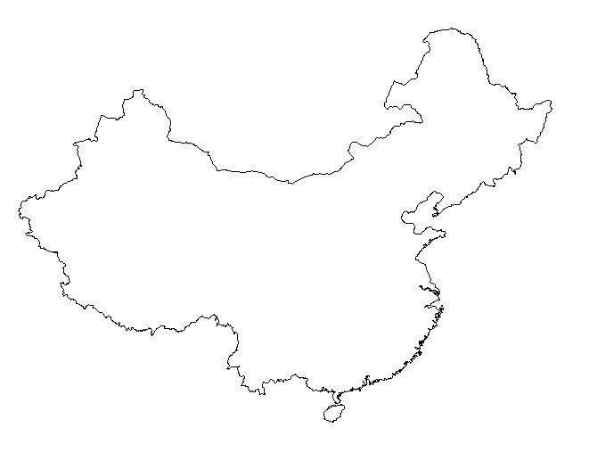

Slide 51
China
Yellow R.
Tibet
Early Civilization begins here
Pacific Ocean
Chang Jiang R.
Himalayas

Slide 52
Dynasty
Dynasty – rulers from the same family or group.

Slide 53
Shang 1650 BC
Western group moves North and controls China
Yin Yang
Ancestor Veneration
King/Emperor

Slide 54
Zhou (JOH or Chou) Dynasty
1045 B.C. – 256 B.C. (longest in China history)
Divided the territory into sections
King appointed governors to lead sections
Feudalism begins
Silk manufacturing
Mandate (authority) from heaven
Heaven kept order through the Zhou king
King must rule by “Dao” the right way
Bad dynasties lost their mandate good ones keep it.

Slide 55
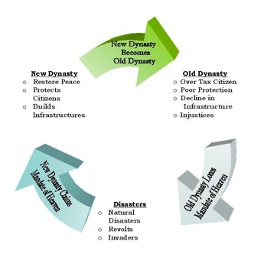

Slide 56
Qin (Chin) Dynasty
221 B.C.- 206 B.C.
Qin Shi Huangdi (one man)
United China
One currency (Money)
Built Roads
Great Wall (in North)
Established Legalism as official ideology
People rule based on merit not family

Slide 57
Han 206 BC
Emperor Wudi
Expanded the empire
Confucianism the system of belief

Slide 58
Philosophies (Religions)
Confucianism
Born in 551 B.C.
Known as first Teacher or Master
Not concern with spiritual
Taught
Duty – needs of family and community over self
Work Ethic to improve life on earth

Slide 59
“If there is righteousness in the heart, there will be beauty in the character. If there is beauty in the character, there will be harmony in the home. If there is harmony in the home, there will be order in the nation. If there is order in the nation, there will be peace in the world. ”

Slide 60
Philosophies (Religions)
Daoism
Laozi
Get in touch with universe
Proper forms of human behavior
Inaction – go with the flow and get in line with the universe.

Slide 61
Philosophies (Religions)
Legalism
People are evil by nature
Strict laws and stiff punishments
Strong leader needed

Slide 62
Empires of the Middle East
Hittites 1400 BC
Israelites 1000 BC
David
Solomon
Assyrians 722 BC
Sargon
Sennacharib
Babylonians 586 BC
Nebuchadnezzar
Exile the Israelites
Old Testament is produced
Persians 530 BC
Cyrus
Darius

Slide 63
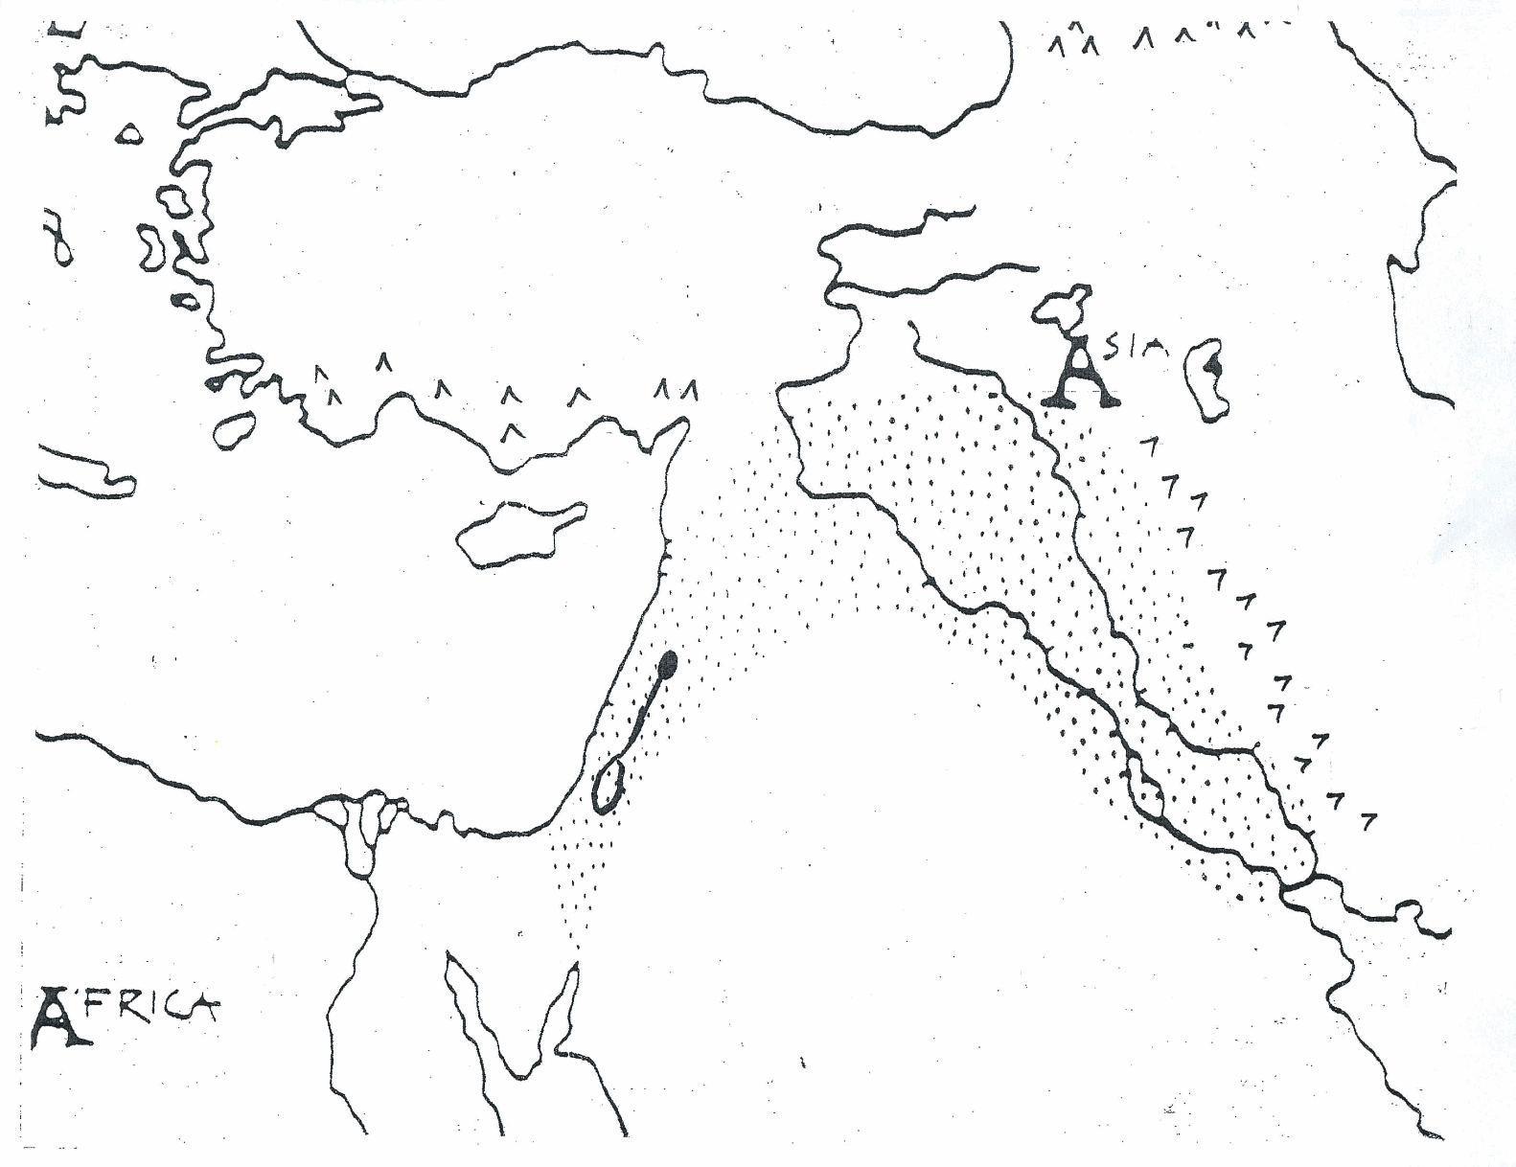
Hittites
Assyrians
Persians
Babylonians
Israelites

Slide 64
Empires of the World
http://www.mapsofwar.com/images/EMPIRE17.swf

Slide 65
Greece

Slide 66
Greece
Geography
Early Civilizations
City States
Government
Culture
Alexander the Great

Slide 68
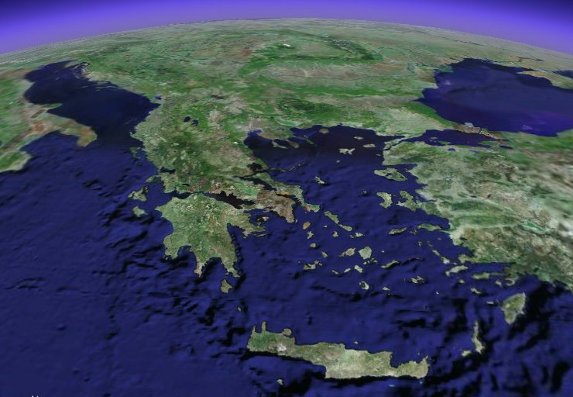

Slide 69
Geography
Peninsula – body of land jutting out into the sea or ocean, water on three sides.
Mount Olympus – highest peak
Aegean Sea and Mediterranean Sea
Island – water on all sides
Crete

Slide 70
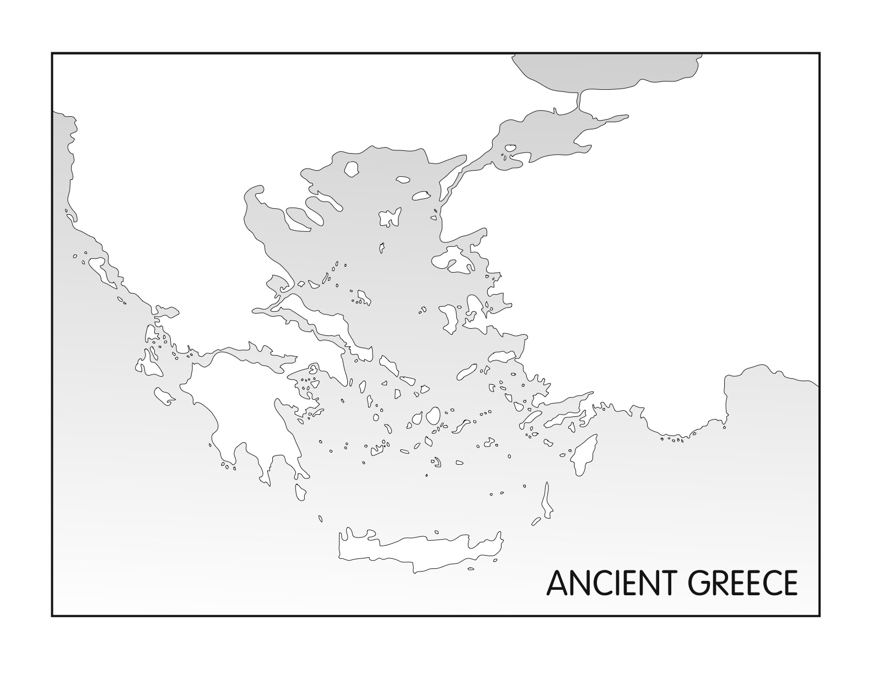

Slide 71
Mt. Olympus
Aegean Sea
Island of Crete
Mediterranean Sea

Slide 72
Early Civilizations
Minoan
Mycenaean
Protected against Persian invasion

Slide 73
City-State
Polis – town, city of people who shared the same identity and goals.
Acropolis – safe place (refuge) during attack, religious center or public building. Built on a hill.
Agora – market place and assembly for public meetings

Slide 74
City – State
Most Famous
Athens
Sparta
Thebes
Impact
U.S. system of levels of government
National and State

Slide 75
Government
Democracy – ruled by the people or the many.
Oligarchy – Rule by the few

Slide 76
Culture
Religion
Art
Philosophy

Slide 77
Religion
Polytheistic
gods and goddesses lived on Olympus
No morality
No teaching
No afterlife
All people went to live with Hades

Slide 78
Religion Cont.
Rituals
Prayers and gifts to the gods
Festivals
Olympics in 776 BC
Temples were major buildings in cities

Slide 79
Religion Cont.
Greek gods
Zeus – King of gods
Hera – Wife of Zeus
Poseidon – god of Sea
Hades – god of underworld
Apollo – god of music and art

Slide 80
Art
Sculpture
Ideal people
Drama
Theaters
Trilogies – set of three plays
Oedipus Rex
Writing of History
Thucydides – father of history

Slide 81
Greek Philosophies
Philosophy – organized system of thought

Slide 82
Philosophers
Pythagoras – geometry, universe can be understood through numbers
Sophist – traveling teachers, no absolute right or wrong, sway people with argument and the art of debate.

Slide 83
Philosophers cont.
Socrates – live by a moral code, question everything.
Plato – student o Socrates, distrusted democracy, wrote “The Republic”
Aristotle – student of Plato, happiness tied to behavior, father of science, observe everything, father of political science.

Slide 84
Alexander the Great
Father was Phillip of Macedonia
Mastered military weaponry
Conquered known world in 11 years
Died at 32

Slide 85
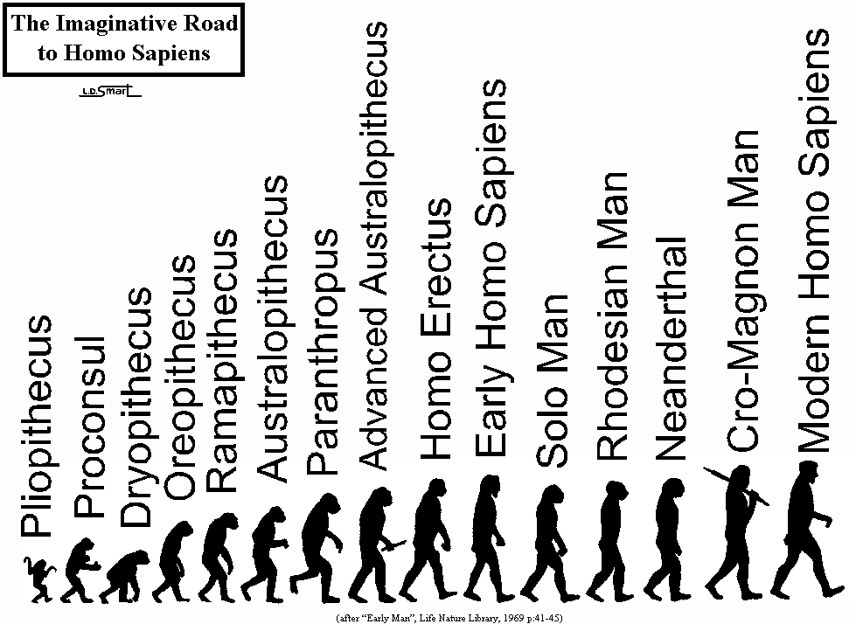
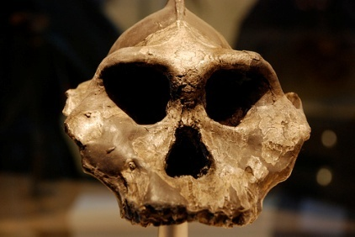
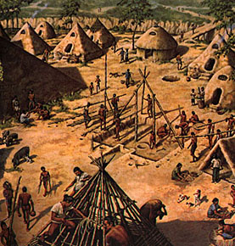
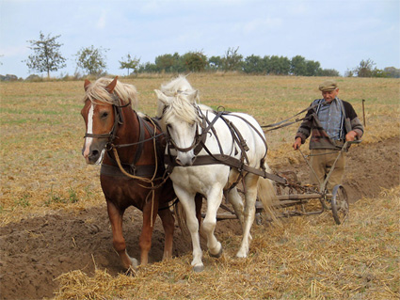
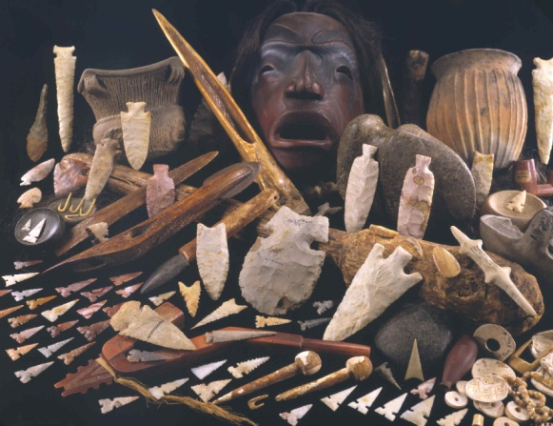
Pre History
3,000,000 BC
Australopithecus
250,000 BC
Homo Sapiens Sapiens
2.500,000 BC
Paleolithic
8,000 BC
Neolithic

Slide 86
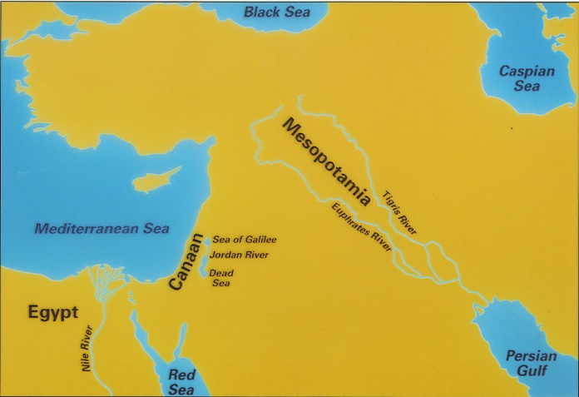
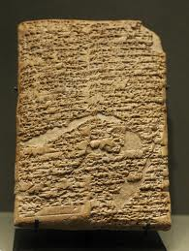
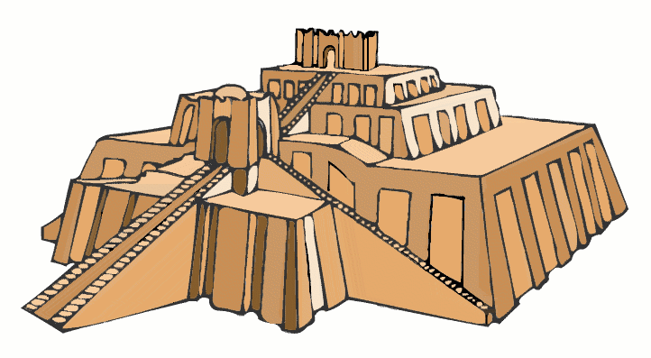
Mesopotamia
1792 BC
Code of Hammurabi
3,000 BC
Sumerian
Babylonians
521 BC
Persians

Slide 87
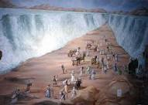
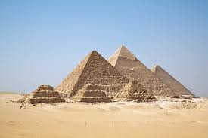
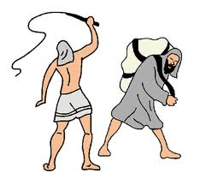
Egypt and Israel
1100 BC
Exodus
2540 BC
Great Pyramids
930 BC
King David
2700 BC
Old Kingdom
332 BC
Alex the Great
1500 BC
Slavery in Egypt
1700 BC
Abraham

Slide 88
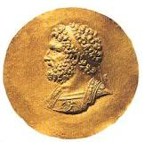
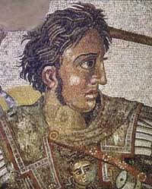
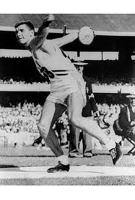
Greece
280 BC
Phillip of Macedonia
1500 BC
Mycenae
500 BC
Classical Greek
1900 BC
Minoans
300 BC
Alex the Great
776 BC
Olympics

Slide 89
Rome

Slide 91
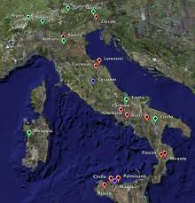

Slide 92
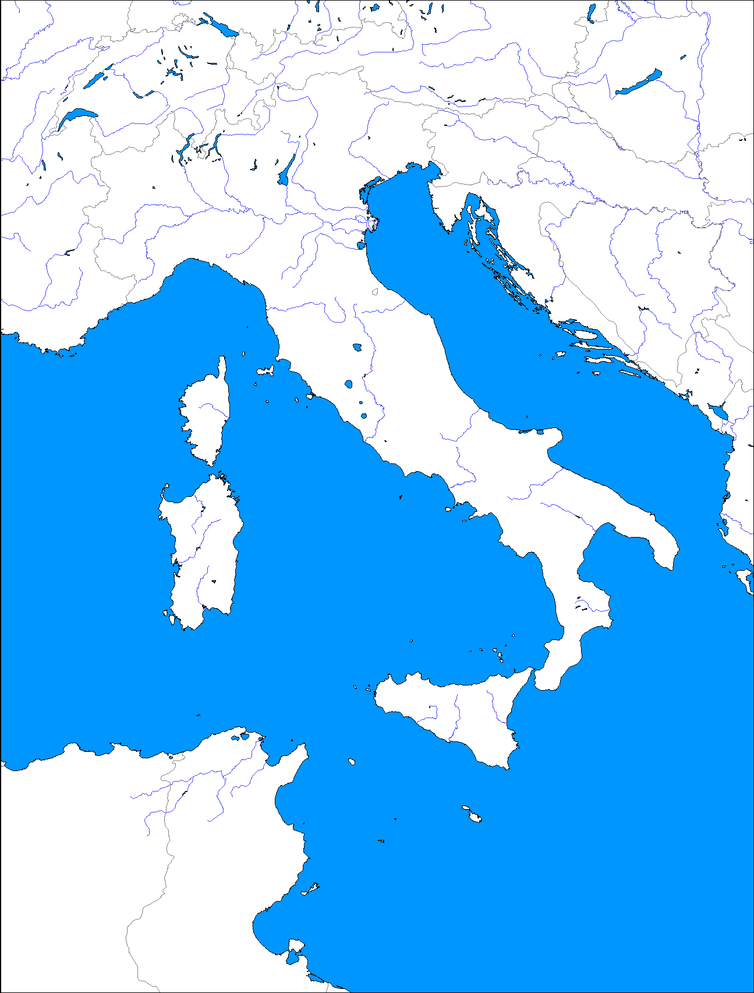
Geography
Peninsula
Apennine Mountains
Adriatic Sea
Ionian Sea
Mediterranean Sea

Slide 93
History of Rome

Slide 94
Early Civilizations
Greeks
Latins
Latins
Greeks
Etruscans
Alphabet
Arch
Etruscans

Slide 95
History of Rome
509 BC drive out Etruscans and their King
Start a republic
Last from 509 – 133 BC

Slide 96
Structure of the Republic
Senate
Made up of Patricians – land owners
Made laws
Consuls
Supervise business and armies
Dictator
Complete control of government
Emergency powers for 6 months

Slide 97
Social Structure
Classes
Patricians (Wealthy)
Plebeians (farmers, traders, merchants)
Gain access to power and equality in 450 BC
Slaves

Slide 98
History of Rome conquest
338 BC Rome defeats Latin states
50 years of Roman conquest of Italian peninsula
264 BC Rome defeats Greeks
264 BC 1st Punic War – War against Carthage for Sicily
Rome wins

Slide 99
Carthage

Slide 100
History of Rome
216 BC 2nd Punic War – War against Carthage
Hannibal – leader of Carthaginians invades Italy
Rome wins gets Spain
129 BC Hellenistic Wars
Greece and Macedonia are Rome’s

Slide 103
Backlash of Success
New Class of Wealthy
Bought huge land areas
Used slave labor
Corrupted government
Farmers could not compete with prices
Had to move to city
Reform movements started

Slide 104
Roman History Cont.
86-31 BC Civil Wars over who will lead
Three leaders emerge but Julius Caesar wins
45 BC Caesar made absolute ruler (dictator) of Rome
Assassinated in 44 BC

Slide 105
New Era of Emperors
Two leaders emerge but Octavian wins and is called Augustus – revered one
31 BC - 14 AD age of Augustus
Ushers in the “Pax Romana” Roman Peace
Last 200 years

Slide 106
Bad Emperors during Pax
Caligula
Nero
Severe persecution of Christians

Slide 107
Spread of Christianity in Rome
Persecution
Mistreatment of believers
Nero most infamous
Blamed Christians for fire of Rome
Constantine – becomes first Roman Emperor to accept Christianity
378 AD Christianity become only religion in Rome

Slide 108
Roman Achievements
Greco-Roman civilization
Architecture
Arch
Engineering
Aqueducts
Sewer systems

Slide 109
More Achievements
Roman Law
Rules of law – not people
Equal under the law
Innocent until proven guilty
Face and defend against accusers
Beyond reasonable doubt
Fair interpretation by judges of laws

