Slide 1


Civics & Economics
Unit Objective
The Three Branches of Government
Unit Notes & Summaries
Unit Compare & Contrast
Unit Graphs & Models
Unit Group Activities
Unit Organizers
Unit Classwork & Practice
Unit Testing & Analysis

Slide 2
Unit Objectives
2.3 – Explain the limits and authorities of government agencies and public officials
2.2 – Explain the organization and framework of the three branches of our government
5.4 – Evaluate the role of debate and compromise in the legislative process

Slide 3
House vs Senate
 | Qualifications | Years in a Term | Term Limits | Leaders | Who do they Represent
Senate
House Of Rep.

Slide 4
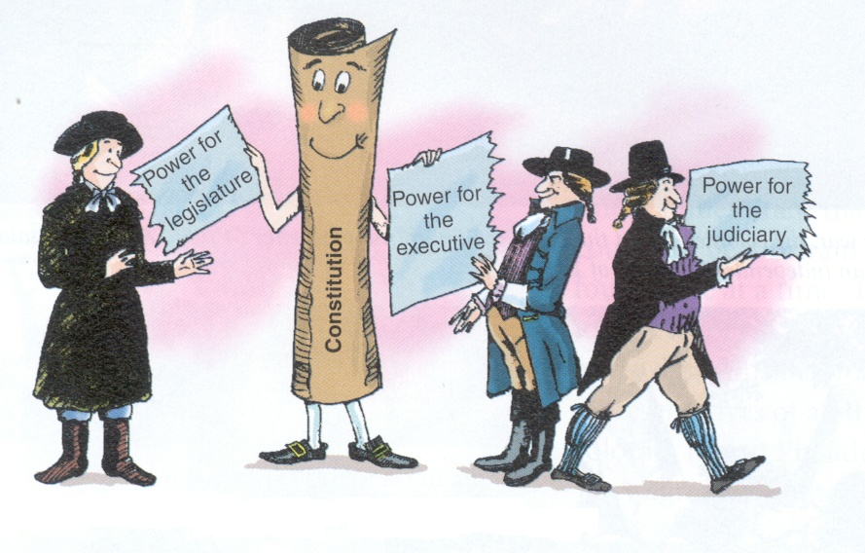
The Legislative Branch
Characteristics of Congress

Slide 5
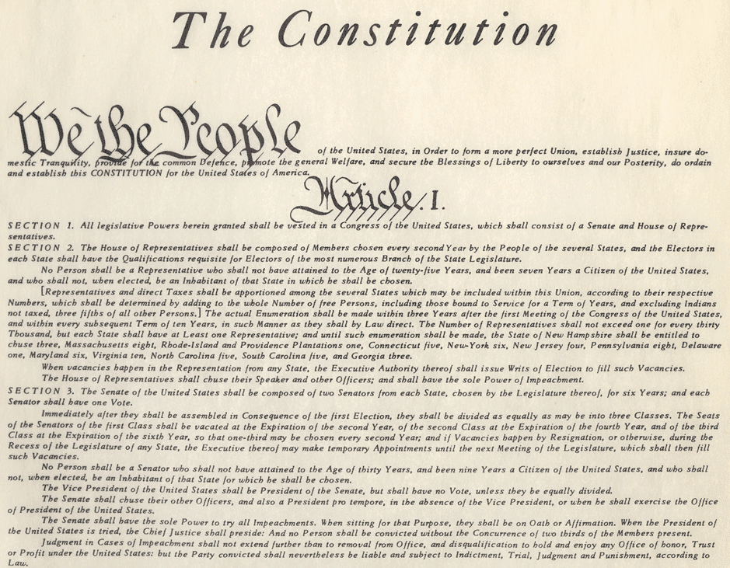
Article 1 Section 1
“All legislative powers herein granted shall be vested in a Congress….”

Slide 6
Legislative Branch
Group of people that make laws
Name is CONGRESS
Split in two houses
  Great Compromise – one for states other for people

Slide 7
Article 1 Section 2
“The House of Representatives shall be….”

Slide 8
House vs Senate
 | Qualifications | Years in a Term | Term Limits | Leaders | Who do they Represent
Senate
House Of Rep.

Slide 9
Article 1 Section 2 Clause 2
“No Person shall be a Representative who shall not have attained to the Age of twenty five Years, and been seven Years a Citizen of the United States, and who shall not, when elected, be an Inhabitant of that State in which he shall be chosen.”

Slide 10
House vs. Senate
 | Qualifications | Years in a Term | Term Limits | Leaders | Who do they Represent
Senate
House Of Rep. | 25 years old Citizen for 7 years Resident of the state
25 years old
Citizen for 7 years
Resident of the state

Slide 11
Article 1 Section 2 Clause 1
“The House of Representatives shall be composed shall be composed of members chosen every second year by the people of the several states.”

Slide 12
House vs. Senate
 | Qualifications | Years in a Term | Term Limits | Leaders | Who do they Represent
Senate 100
House Of Rep. 435 | 25 years old Citizen for 7 years Resident of the state | 2 Years
2 Years

Slide 14
House vs. Senate
 | Qualifications | Years in a Term | Term Limits | Leaders | Who do they Represent
Senate 100
House Of Rep. 435 | 25 years old Citizen for 7 years Resident of the state | 2 Years
No Limits

Slide 15
Article 1 Section 2
“The House of Representatives shall choose their Speaker and other Officers...”

Slide 16
House vs. Senate
 | Qualifications | Years in a Term | Term Limits | Leaders | Who do they Represent
Senate
House Of Rep. 435 | 25 years old Citizen for 7 years Resident of the state | 2 Years | No Limits | Speaker of the House
Speaker of
the House

Slide 17
Article 1 Section 2
“The number of Representatives shall not exceed one for every thirty-thousand, but each state shall have at least one….”

Slide 18
House vs. Senate
 | Qualifications | Years in a Term | Term Limits | Leaders | Who do they Represent
Senate
House Of Rep. | 25 years old Citizen for 7 years Resident of the state | 2 Years | No Limits | Speaker of the House | Districts
Districts

Slide 19
Article 1 Section 2
“The number of Representatives shall not exceed one for every thirty-thousand, but each state shall have at least one….”

Slide 20
If we still used 30,000
NC 9,752,073 current population
  Divided by 30,000 = 325 reps
California’ current population 38,041,430
  Divided by 30,000 = 1268 reps

Slide 21
Article 1 Section 2
“The number of Representatives shall not exceed one for every thirty-thousand, but each state shall have at least one….”
700,000

Slide 22

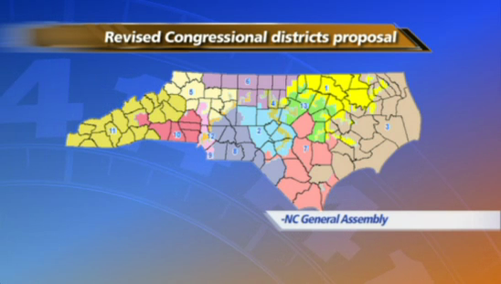
10
700,000 per district

Slide 23
What if a state gains or looses people?

Slide 24
Article 1 Section 2 Clause 3
“By adding to the whole number…every ten years in such manner by law direct...”

Slide 25
Census
Taken every ten years to determine the number of representatives each state gains or looses.
The house number was set at 435 in 1929.
  The building is not big enough to hold so many.
  The increase in technology enabled better communication with constituents (people in districts)

Slide 26
House vs. Senate
 | Qualifications | Years in a Term | Term Limits | Leaders | Who do they Represent
Senate
House Of Rep. 435 | 25 years old Citizen for 7 years Resident of the state | 2 Years | No Limits | Speaker of the House | Districts
435
Districts

Slide 27
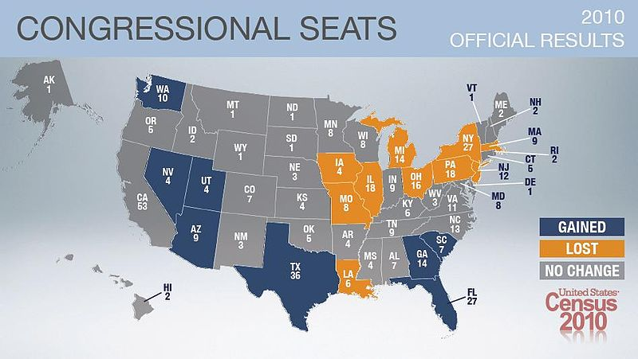

Slide 28
House vs. Senate
 | Qualifications | Years in a Term | Term Limits | Leaders | Who do they Represent
Senate
House Of Rep. 435 | 25 years old Citizen for 7 years Resident of the state | 2 Years | No Limits | Speaker of the House | Districts

Slide 29
Article 1 Section 3
“The Senate of the United States shall be….”

Slide 30
Article 1 Section 3 Clause 3
“No person shall be a Senator who shall not have attained to the age of thirty years, and been nine years a citizen of the U.S., and who shall not, when elected, be an Inhabitant of the State for which he shall be chosen...”

Slide 31
House vs. Senate
 | Qualifications | Years in a Term | Term Limits | Leaders | Who do they Represent
Senate 100 | 30 years old Citizen for 9 years Resident of the state
House Of Rep. 435 | 25 years old Citizen for 7 years Resident of the state | 2 Years | No Limits | Speaker of the House | Districts

Slide 32
Article 1 Section 3 Clause 1 & 2
“for six years... One third may be chosen every second year”

Slide 33
House vs. Senate
 | Qualifications | Years in a Term | Term Limits | Leaders | Who do they Represent
Senate 100 | 30 years old Citizen for 9 years Resident of the state | 6 Years Staggered Election
House Of Rep. 435 | 25 years old Citizen for 7 years Resident of the state | 2 Years | No Limits | Speaker of the House | Districts

Slide 35
House vs. Senate
 | Qualifications | Years in a Term | Term Limits | Leaders | Who do they Represent
Senate 100 | 30 years old Citizen for 9 years Resident of the state | 6 Years Staggered Election | No Limits
House Of Rep. 435 | 25 years old Citizen for 7 years Resident of the state | 2 Years | No Limits | Speaker of the House | Districts

Slide 36
Article 1 Section 3 Clause 4
“The Vice President of the U.S. shall be President of the Senate… Senate shall choose officers and a President pro tempore, in the absence of the V.P. ...”

Slide 37
House vs. Senate
 | Qualifications | Years in a Term | Term Limits | Leaders | Who do they Represent
Senate 100 | 30 years old Citizen for 9 years Resident of the state | 6 Years Staggered Election | No Limits | Vice President & President Pro Tempore
House Of Rep. 435 | 25 years old Citizen for 7 years Resident of the state | 2 Years | No Limits | Speaker of the House | Districts

Slide 38
Article 1 Section 3 Clause 1
“The Senate of the United States shall be composed of two Senators fro each State…

Slide 39

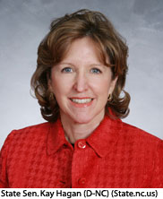
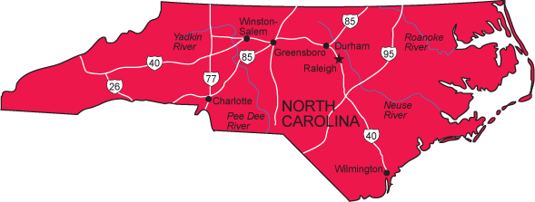

Slide 40
House vs. Senate
 | Qualifications | Years in a Term | Term Limits | Leaders | Who do they Represent
Senate 100 | 30 years old Citizen for 9 years Resident of the state | 6 Years Staggered Election | No Limits | Vice President & President Pro Tempore | The Entire State Selected by a state election
House Of Rep. 435 | 25 years old Citizen for 7 years Resident of the state | 2 Years | No Limits | Speaker of the House | Districts

Slide 41
Powers of Congress
Powers of House | Powers of Senate | Limits on Congress
Vote on Charges of impeachment | Try an impeached officials | Can’t take away your Due Process Rights
Propose bills for raising revenue (tax laws) Appropriations Bills | To confirm presidential appointments (2/3rds vote) | No Bills of Attainder
Chooses the President if the Electoral College does not have a majority | To Ratify Treaties (2/3rds vote) | Writ of Habeaus Corpus
 | Filibuster / Cloture | No Ex Post Facto Laws

Slide 42
Bicameral Legislature FRQ
Grading Scale
6=A
5=B
4=C
3=D
2 or less = F
The Framers of the US Constitution created a legislative system that is bicameral. However, it is not just bicameral; the framers also established two houses of distinctly different character and authority.
Explain what a bicameral legislature is and why the framers created a bicameral legislature (think great compromise). (2 points)
Identify one power unique to the House of Representatives and explain why the framers gave the House that power. (2 points)
Identify one power unique to the Senate and explain why the framers gave the Senate that power. (2 points)

Slide 43
Leadership in Congress

Slide 44
How Congress Functions
Committees

Slide 45
House
Senate
Speaker of House
  Elected by the House majority party
  Recognizes speakers
  Controls floor debate
Majority Leader
Minority Leader
Vice President
  Leader/Const.(never there)
  Votes only if there is a tie
President Pro Tempore
  Real leader
Majority Leader
Minority Leader

Slide 46
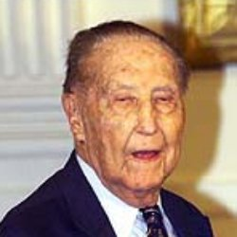
Types of Committees
Standing – permanent committees
Select – temporary committees
Joint – combination of House & Senate
  Conference committee – a special committee set up to iron out the differences in the House and Senate versions of a bill.
The best committee positions are assigned to the congressmen who have served the longest = seniority system.

Slide 47
Purpose of Committees
To put people in specific areas they specialize in to keep stupid bills from being debated.

Slide 48
Only House and Only Senate
Committees
Ways and Means Committee
(Taxes)
Senate
Judiciary Committee
(Hearings)
Rules Committee
(traffic cop)
Foreign Relations Committee
House

Slide 49
What Committees Do?
Call in smart people to tell them what’s up.
  Interest groups
  Agencies
  Businessmen
Write up the bill so it is worded good b4 debate.

Slide 50
Main Function of Congress
Making Laws

Slide 51

How does a bill become a law
Introduction
Committee
Floor Debate
Senate or House
President
Conference Committee

Slide 52
Floor Debate
Argue the pros and cons of the bill.
Only House has RULES for Debate
Only Senate is allowed to attach riders- unrelated bills.
Only Senate allowed to filibuster-debate a bill to death.
  Hope sponsors will w/draw bill.
Senators can end a filibuster or limit debate time with a 3/5 (60) vote=cloture.
1964-Senators debate the Civil Rights Act for 74 days.
  Record 24 hrs 18 min.- Strom Thurmond

Slide 53
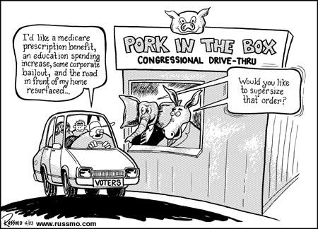
Pork Barrel Spending
Work to send federal $ and jobs back to your district.
  Pork-barrel projects.
    Pork-barrel=Federal treasury
    Fat=a project.
Senator Byrd from W VA is known for “bringin’ home the bacon!” with Federal projects to W VA

Slide 54
Key Terms
Franking privilege- send mail for free to constituents. Helps during reelection time.
Constituents = people that a delegate represents.

Slide 55
The Executive Branch
Characteristics of the President

Slide 56
Organization of Executive Branch
Pres.
VP
Cabinet
Departments
Bureaucracy
Agencies

Slide 57
Qualifications, Pay, and Perks
Qualifications
Must be 35 years old
Must be born in the United States
Must be a citizen for the last 14 years
Pay
$400,000 salary + travel expenses
Perks
Use of Camp David
Personal car, helicopter and a specially equipped jet airplane
Personal staff to care for your family (80 ppl)
Free House to live in with pool, bowling alley and theater

Slide 58
How we elect the President
Electoral College

Slide 59
Winner-take-all System
If you win the states popular vote by a majority you get all of the electoral votes.
  51% gets you 100%
NO proportional division
  Get 35% you get 35% of the electors
  Get 25% you get 25% of the electors

Slide 60
How do they get the # of electors?
Number of Representatives + Senators = Electors
Ex:
  NC has 13 Reps + 2 Senators = 15 electors
TOTAL number for the U.S. is 537
  **DC gets 2

Slide 61
Magic Number
270
Popular Vote (number of total people voting for you) does NOT matter!

Slide 62
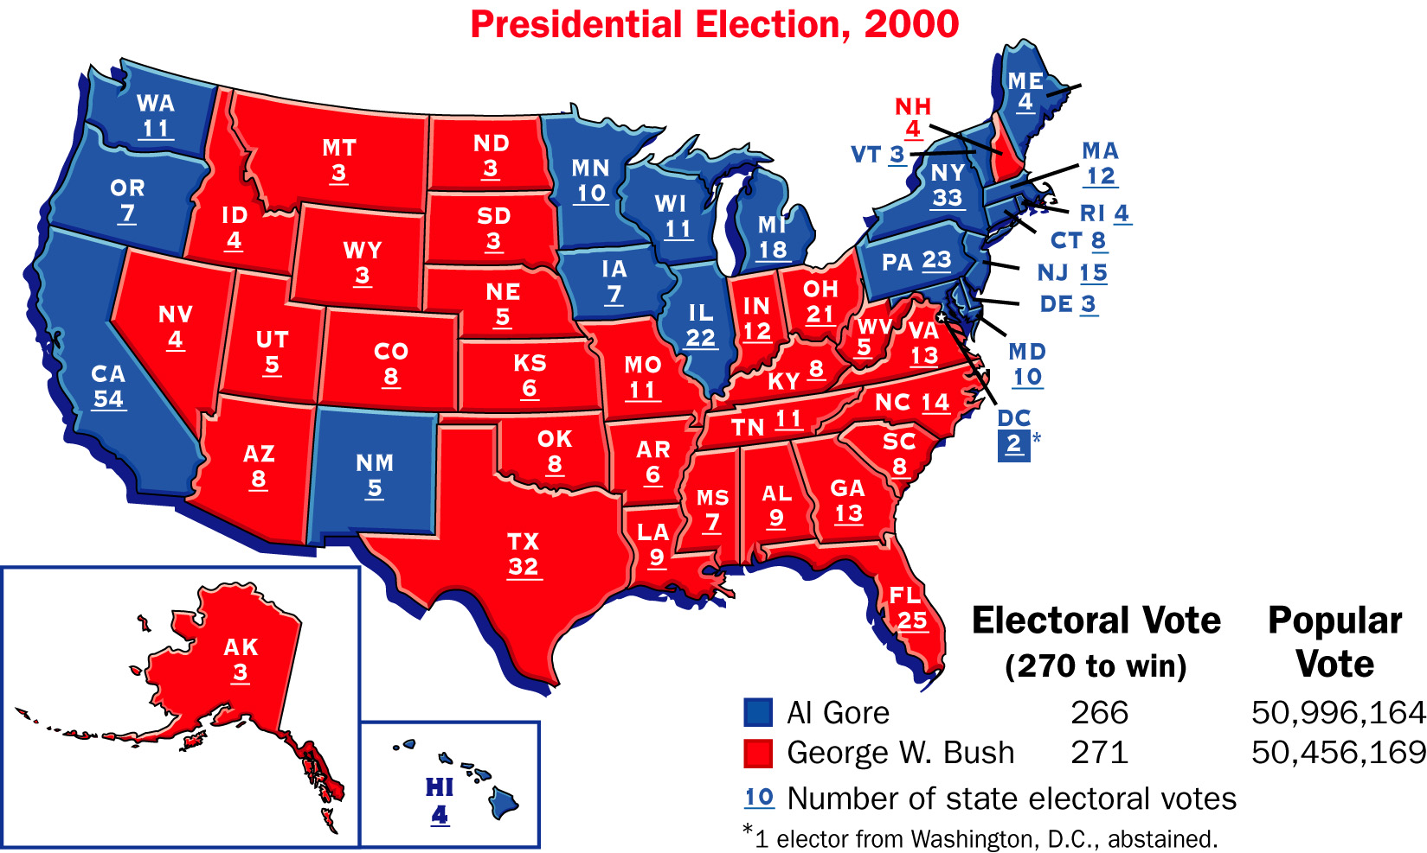
Electoral College

Slide 63
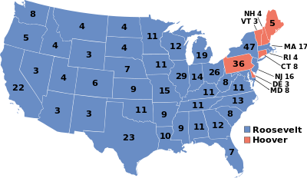

Slide 64
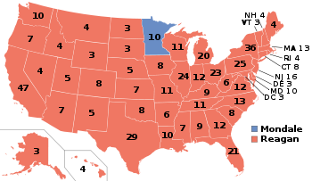

Slide 65
Assignment
What is the minimum number of states needed to win the election?
Which states would you most likely campaign in if you were a candidate and which states would you not?
How do states get their number of electors?
Can a states number of electors change?

Slide 66
Terms of Office
4 year terms
George Washington steps down after 2 terms
  Everyone else did the same until…
  FDR 1944 elected to his 4th term
  Congress sees a problem and ….
22nd Amendment
  Limited to 2 terms (8 years)

Slide 67
So what if he/she dies?
1963 JFK assassinated
  Who….?
25th Amendment
  Presidential succession

Slide 68
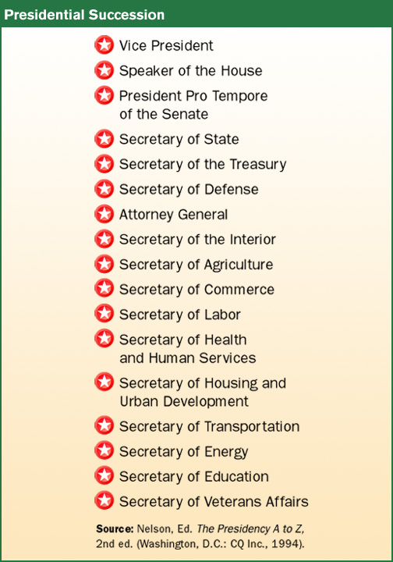
Presidential Succession

Slide 69
Assignment
Make a brochure explaining the roles and powers of the President.

Slide 70
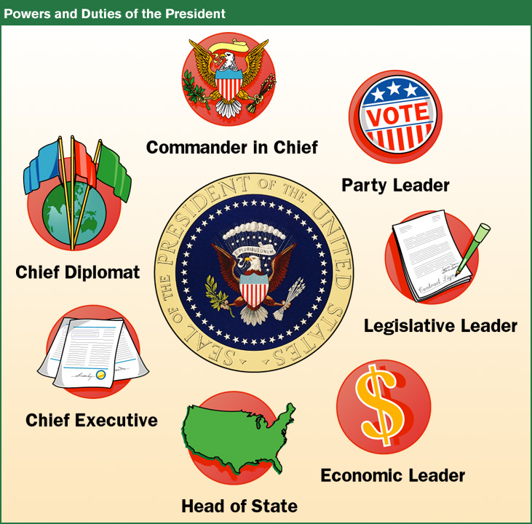
Roles of the President

Slide 71
Assignment
Make a brochure explaining the roles and powers of the President.

Slide 72
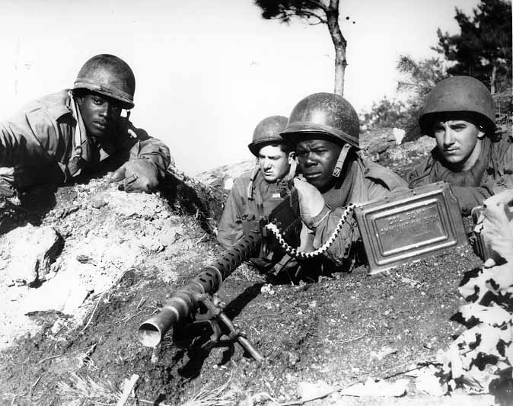
Chief Executive
Executive orders -rule with the force of law made by Pres.
Does not require Congress’ approval.
  1948 Truman integrates Armed Forces.
  2001 Bush adds Homeland Security to cabinet through Executive Order
Pardon-forgiven
Amnesty-forgive group
  illegal immigrants
Reprieve-delay
Integrated Army during the Korean War.

Slide 73
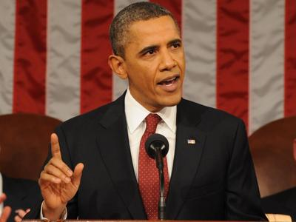
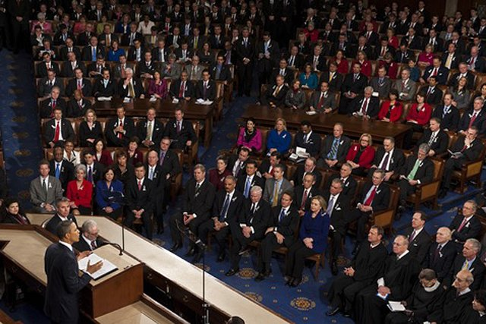
Head of State
Delivers the annual State of the Union address before members of Congress.
  Outlines of the plan for that year.
  Budget and spending

Slide 74
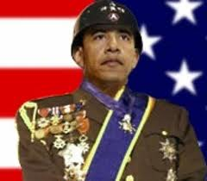
Commander in Chief
Head of Armed Forces
  Must ask Congress to declare war. (Checks and balances)
Limit
War Powers Act -Can send troops into battle, but must notify Congress within 48 hours. (90 day limit)

Slide 75
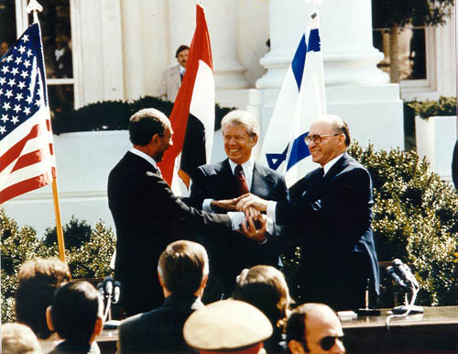
Chief Diplomat
Foreign Policy
4 Goals
  National security
  International trade
  Keep Peace
  Promote democracy

Slide 76
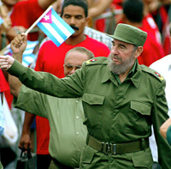
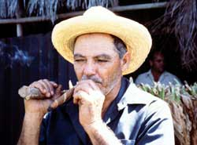
Chief Diplomat
Tools
  Treaty-Senate approval (2/3 vote)
Appoint ambassadors- our gov’t representative overseas.
Trade sanctions
  Embargo-prohibits a company from trading with a country.
    No Cuban Cigars

Slide 77
Organization of Executive Branch
Pres.
VP
Cabinet
Departments
Bureaucracy
Agencies

Slide 78
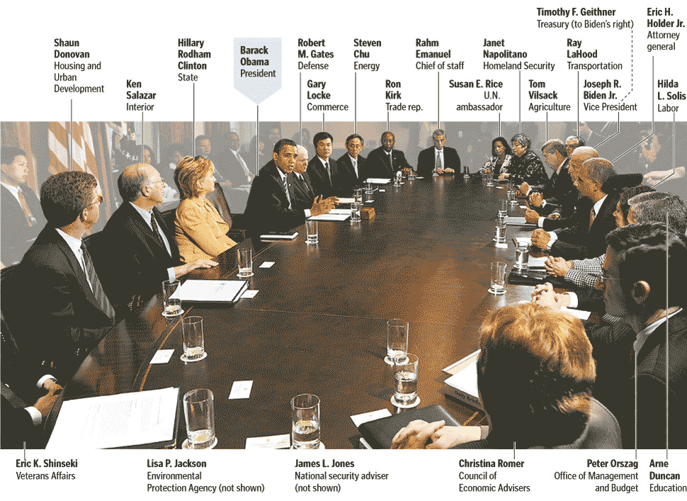
President
15 Departments/Cabinet

Slide 79
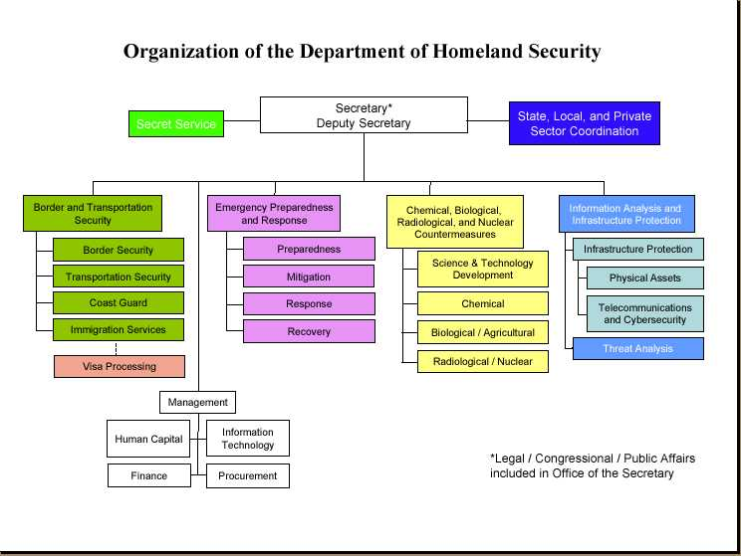
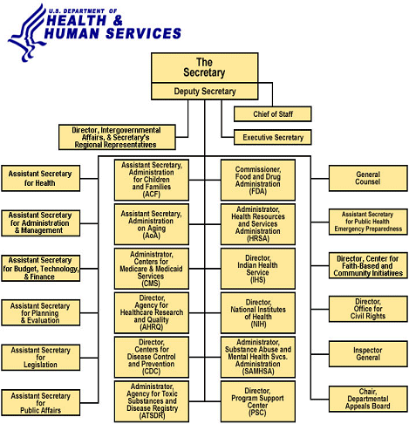
President
15 Departments/Cabinet
Agencies

Slide 80
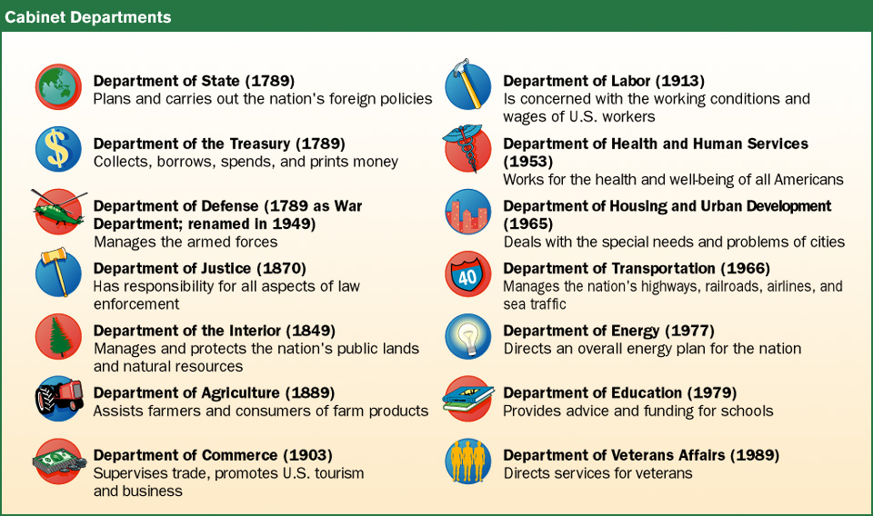

Who works for the President?
Cabinet = Presidential Advisors
  GW starts with 3
15 Executive Departments
3 Types of agencies independent of the President.
  Make administrative laws

Slide 81
Independent Agencies
Executive Agencies
FBI & CIA
Medicare
Medicaid
FEMA
IRS
FDA
DEA & CDC
Regulatory
Commissions
FCC
Federal Reserve
FTC
SEC
Government
Corporations
Post Office

Slide 82
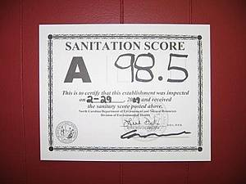
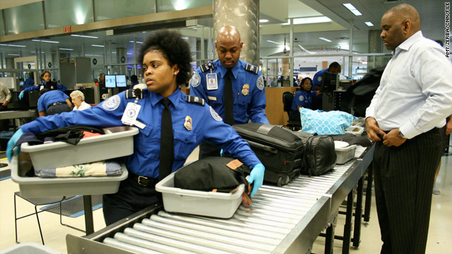
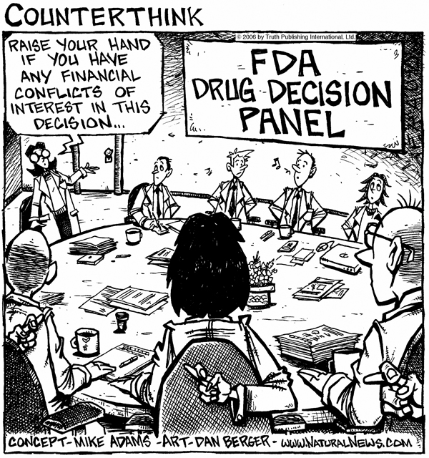
More about agencies
National Security
  FBI
  CIA
  Homeland Security
Transportation
  DOT
Immigration and Naturalization (INS)
IRS (taxes)
FDA - food and drug

Slide 83
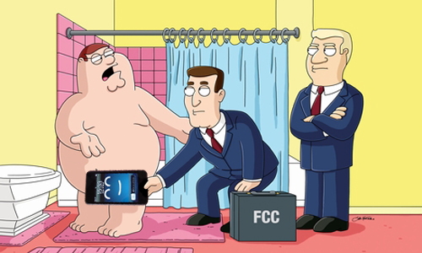
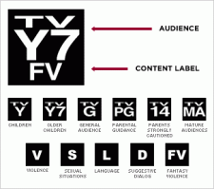

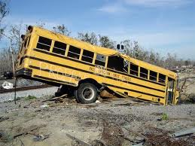
More about agencies
Crime and Drugs
  DEA
  ATF
Health and Human Services
  FEMA
  Center for Disease Control
FCC
  Radio and TV

Slide 84
Unit Objectives
2.2 – Explain the organization and framework of the three branches of our government
5.2 – Identify the jurisdiction of state and federal courts

Slide 85
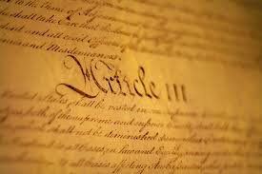
The Judicial Branch
Characteristics of our Court System

Slide 86
Judicial means
Pertaining to administering(applying) justice (fairness), dealing with making judgments about what is fair.

Slide 87
Article 3 Section 1
The judicial Power of the United States, shall be vested in one supreme Court, and in such inferior Courts as the Congress may from time to time ordain and establish. The Judges, both of the supreme and inferior Courts, shall hold their Offices during good Behavior, and shall, at stated Times, receive for their Services a Compensation which shall not be diminished during their Continuance in Office.

Slide 88
How Judicial Branch is Organized?
District Court
Appeals Court
Supreme Court
Supreme Court
inferior Courts
Appeals Courts
District Courts

Slide 89
Article 3 Section 1
The judicial Power of the United States, shall be vested in one supreme Court, and in such inferior Courts as the Congress may from time to time ordain and establish. The Judges, both of the supreme and inferior Courts, shall hold their Offices during good Behavior, and shall, at stated Times, receive for their Services a Compensation which shall not be diminished during their Continuance in Office.

Slide 90
District Court
Why
To determine innocent or guilty
Who
Judge – Jury – Marshall – Magistrate - US Attorney
  Created by the Judiciary Act
What
Try FEDERAL crimes
Disputes b/t states
Power
Complete 90% of all the court’s work
Original jurisdiction – hear cases first

Slide 91
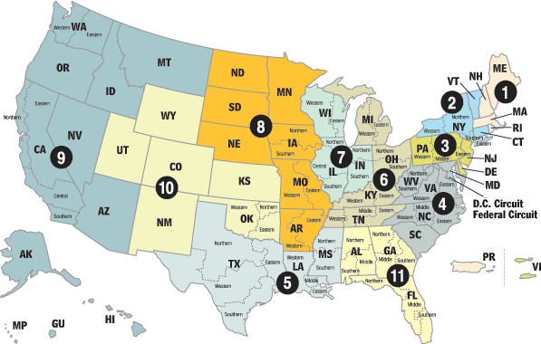
Court of Appeals
Why
To determine if a person’s rights have been violated.
Who
4-23 Judges
No Juries
There are 12 US court of appeals
  Each one has jurisdiction over a circuit, or geographical area.
What
Decide if District Court got it right.
Power
Decision is usually final but can be appealed once more.
Appellate Jurisdiction – hear cases from lower courts.

Slide 92
Supreme Court
Why
To decide if a law is constitutional.
Who
9 judges
Leader = Chief Justice
What
Hear cases that pose significant legal questions.
Power
Have appellate jurisdiction
Judicial Review.
  The power to declare laws unconstitutional.
  Established by court case Marbury vs Madison.
Rulings are like laws
  Sets precedent

Slide 93
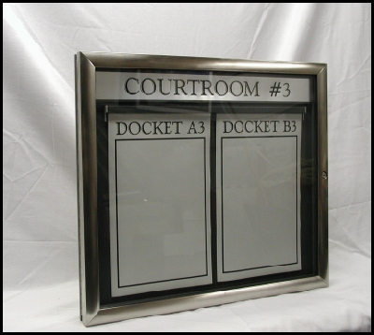
US Supreme Court
Practice Judicial Review- Marbury v. Madison 1803
  decide if laws are constitutional!
Issue writ of certiorari- agree to hear a case from a lower court (send up the records).
Stare decisis- let decision stand - precedent for future
Put case on docket-calendar
Lobbyists and lawyers submit legal briefs trying to persuade the justices.
  Amicus curiae- friend of the court brief!!!!

Slide 94
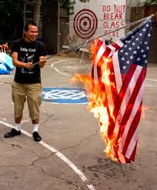
Supreme Court
Decisions
Decision of court has the force of law.
Justices write opinions.
3 types:
  Majority-becomes law
  Concurring-agree with majority but for another reason.
  Dissenting-disagree and explain why; can be used in later cases.

Slide 95
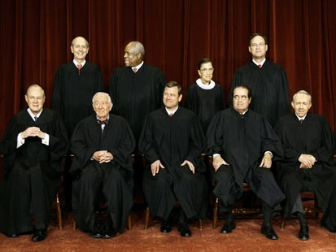
Continued...
Affirm- lower courts decision stands
Reverse- lower courts decision overruled
Remand- send back to lower courts for retrial
  use new procedure ala Gideon

Slide 96
Separation of Powers /
Checks & Balances
FRQ
Grading Scale
10=A+
9=A-
8=B+
7=B-
6=C+
5=C-
4=D+
3=D-
2 or less = F
The Framers of the US Constitution created a system of government that would not only separate the powers given to the national government, but also allow each separate branch to check the powers of the other branches.
Explain how the Framers separated the powers given to the national government, the people or groups of people that make up each branch, and the specific purpose of each different branch. (3 points)
Explain the system of checks and balances that the Framers created and give specific examples of how each branch of government may check the powers of the other branches. (7 points)

Slide 97
Plessy v. Ferguson

