Slide 1
Causes of the Great Depression

Slide 2
Causes
Speculation…
Easy…
Global…
Bank…

Slide 3
Speculation and margin buying
Speculation…

Slide 4
Margin…

Slide 5
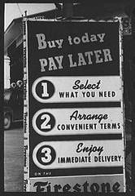
Easy Credit
Installment...

Slide 7
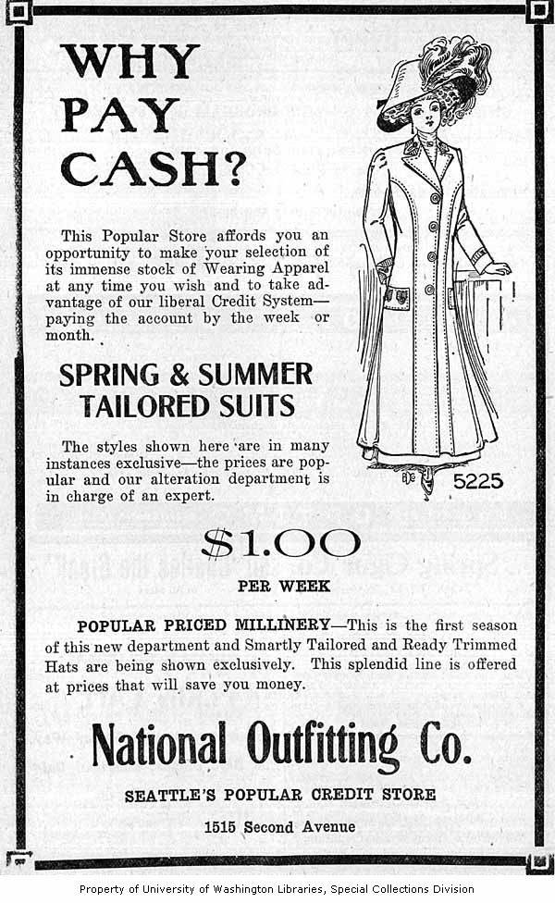

Slide 8
Global Depression and US policies
European …
They …
We...

Slide 9
Bank Runs
Bank …

Slide 10
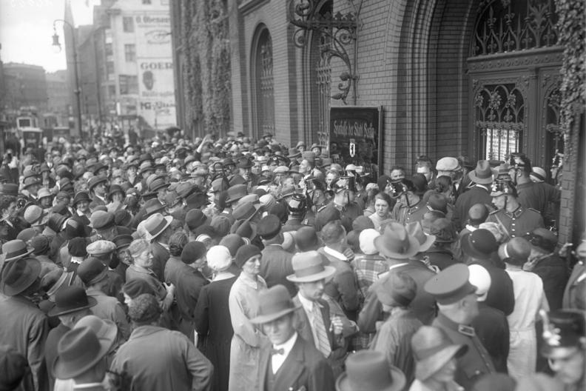

Slide 11
Bank Failures
Bank…

Slide 12
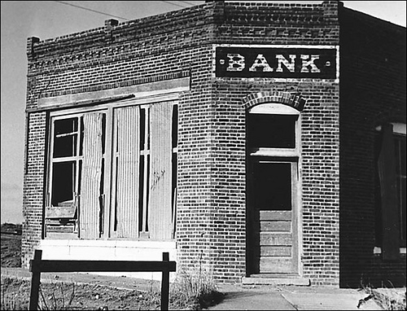

Slide 13
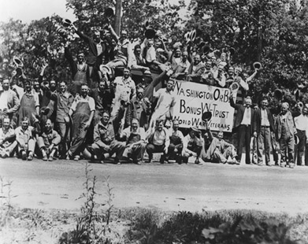
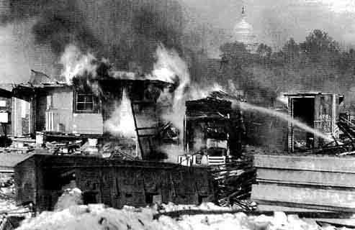
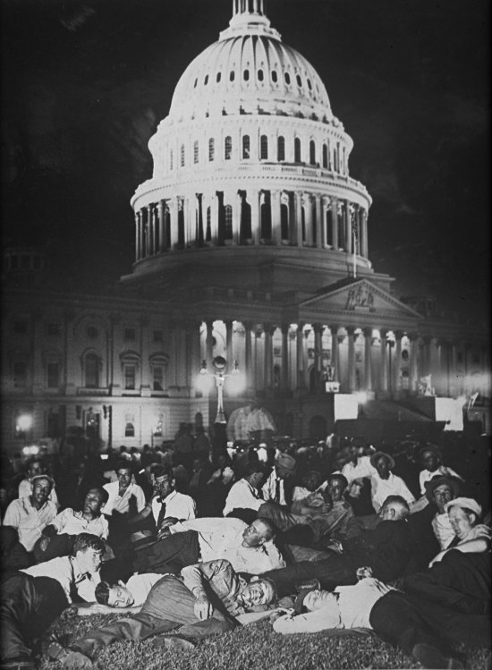
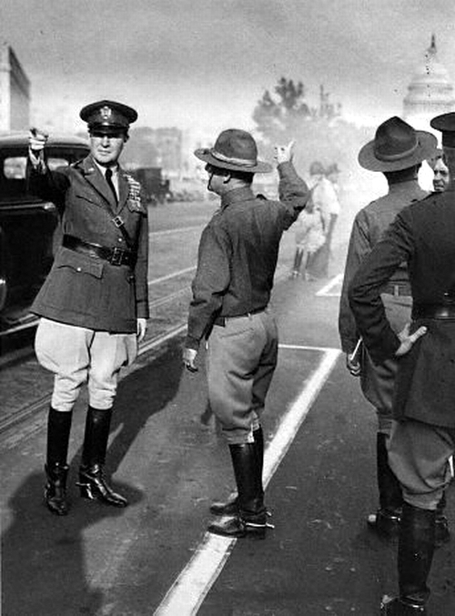
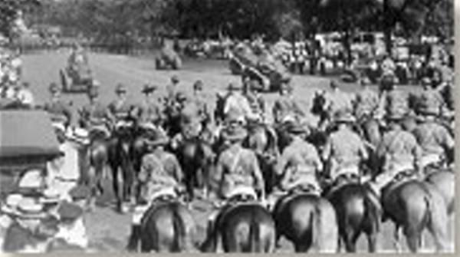
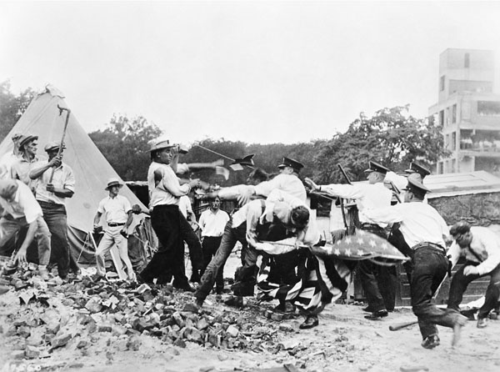
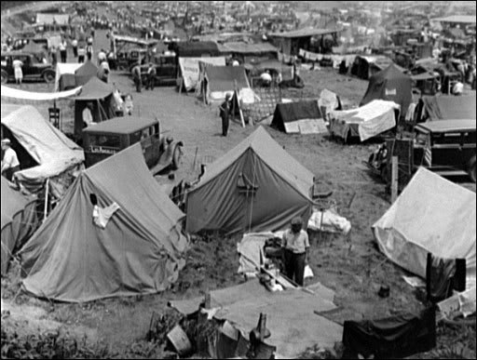

Slide 14
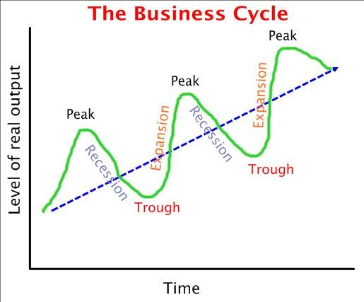
Depression

Slide 15
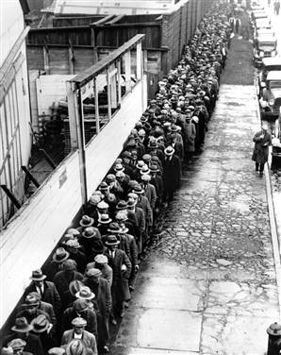
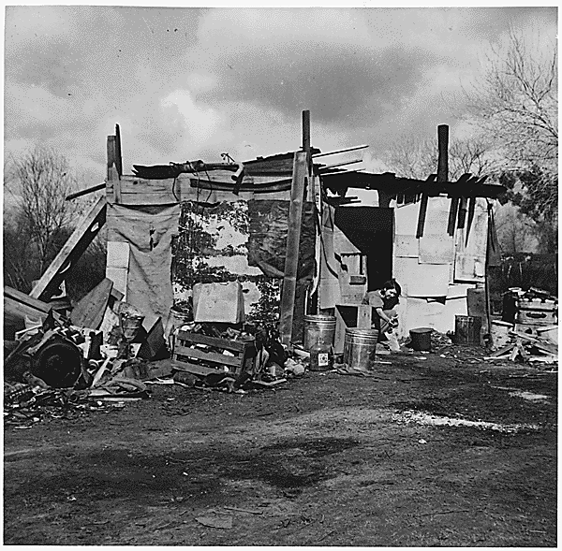
Other Causes…
Agricultural …
Industrial …
Increasing…
Capital …
Political…

Slide 16
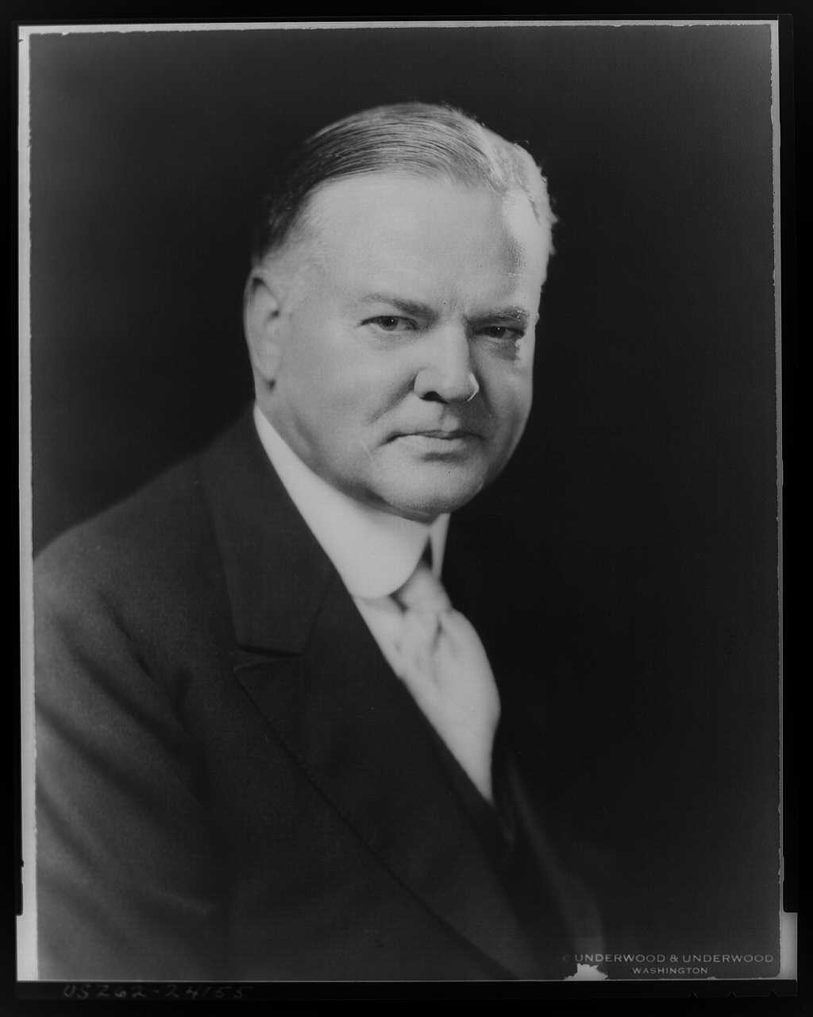

Slide 17
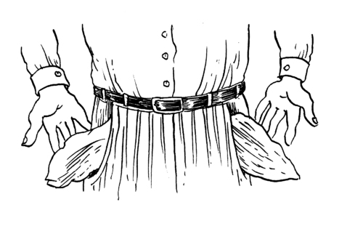
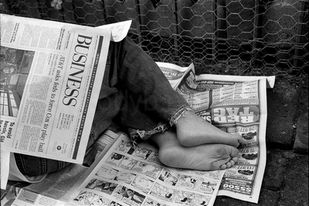
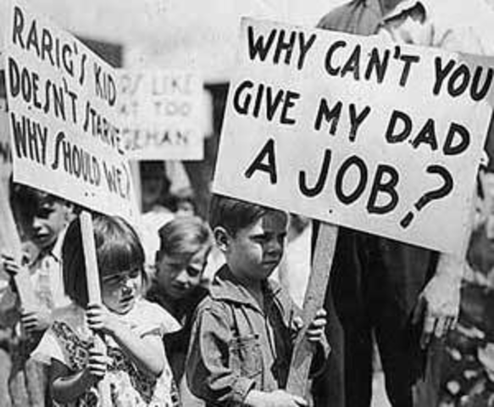
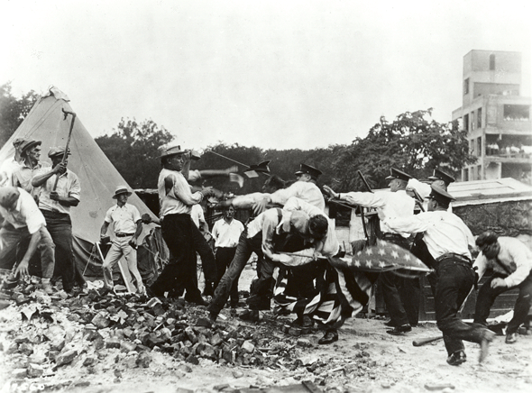

Slide 18
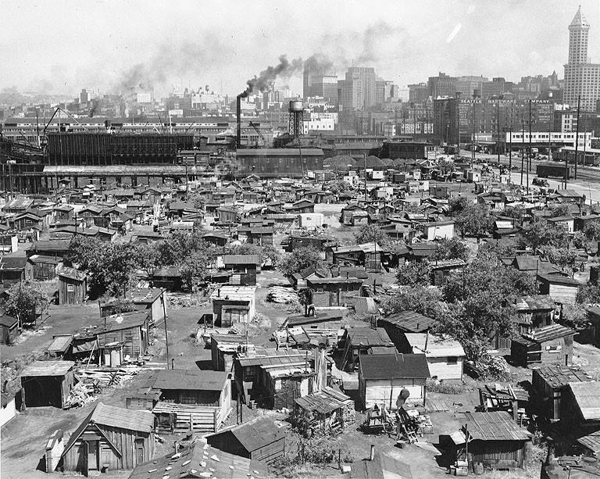

Slide 19
What did Hoover do?
Did not do
Direct Relief
Intervene
Did do
Built
Reconstruction

Slide 20
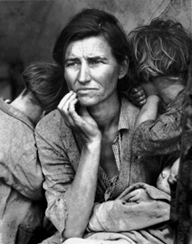
Looking at this image I want you to type a 1st person perspective paper based on what this woman would say. Include:
What life was like for her before the depression.
Job, married, home owner, leisure time, hope for children, etc.
What caused her current condition.
Who she blames and what she feels needs to happen?

Slide 21
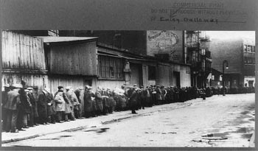
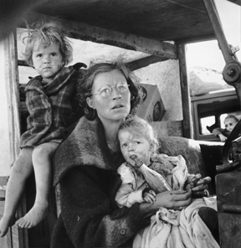
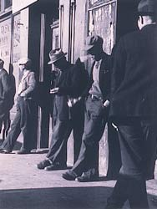
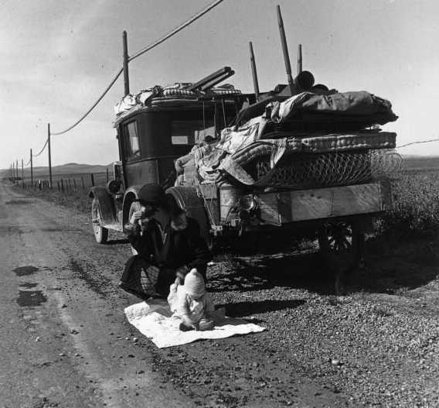
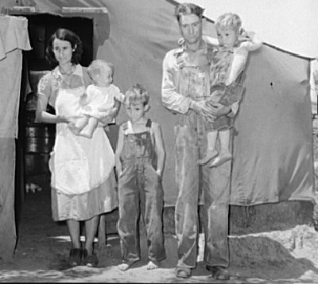
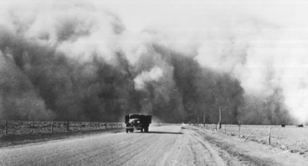
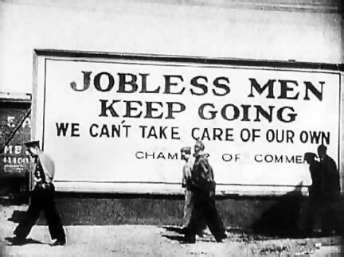
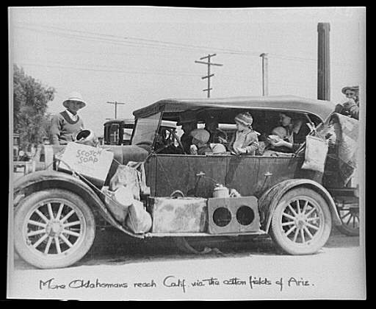
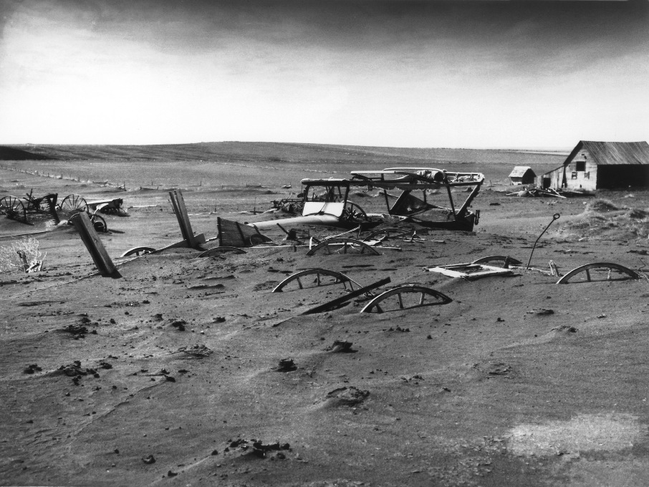

Slide 22
“Title Your Paper Here”
Write your paper here and fill up the box…..

Slide 23
Election 1932
Hoover vs. FDR

Slide 24
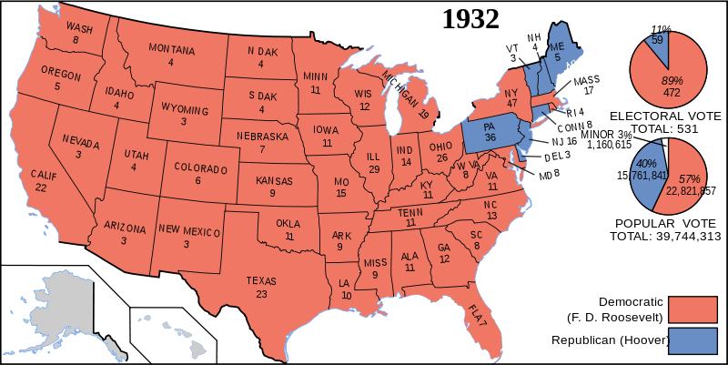

Slide 25
Fifteen years ago my public duty called me to an active part in a great national emergency, the World War. Success then was due to a leadership whose vision carried beyond the timorous and futile gesture of sending a tiny army of 150,000 trained soldiers and the regular navy to the aid of our allies. The generalship of that moment conceived of a whole Nation mobilized for war, In my calm judgment, the Nation faces today a more grave emergency than in 1917.

