Slide 1
Achievement of Social Goals of Equality
“All men are created equal…”

Slide 2
Civil Rights Strategy
Legal Challenges
Get the issue heard in court
Direct Action
Non-Violent
Sit-ins, boycotts, freedom rides, marches, voter registration drives

Slide 3
Key Events
54’ Brown v. Board (Warren Court 53-69)
55’ Emmett Till
55’ Rosa Parks
57’ Little Rock Nine
60’ Greensboro Sit-In
63’ Bull Connor in Birmingham
63’ 16th Street Baptist Church bombed

Slide 4
Tactical Divisions
SCLC – Martin Luther King Jr
Non-Violent shifts in the late 1960’s
SNCC – Marion Berry (Raleigh, NC)
Stokely Carmichael – “black power” black nationalism
Malcom X – “any means necessary”
Riots – Watts, LA, Detroit, MI, Chicago, IL

Slide 5
Resistance
Southern Congressional Response
Whites
KKK lynching’s, burn and bomb churches, buses, kidnapping and beatings
States
Local Courts
Acquitted whites accused of crimes
Local Police
Dogs, water hoses, and arrested

Slide 6
Key Events
64’ freedom summer
64’ Chaney, Goodman, Schwerner found
65’ Malcolm X killed
65’ Selma, Pettus Bridge “Bloody Sunday”
65’ Voting Act passed
68’ Martin Luther King killed
68’ Robert Kennedy killed
71 Swann case in Charlotte

Slide 7
Federal Government
Supreme Court Decisions
Desegregation
Armed forces 1948 Ex. Order 9981 Truman
Legislation
60’ Fed inspect voter registration
64’ prohibits discrimination “some public places”
65’ voting
65’ affirmative action Ex. Order 11246
68’ housing

Slide 8
Vietnam
….Distrust of the Government

Slide 9
The Declaration of the French Revolution made in 1791 on the Rights of Man and the Citizen also states: "All men are born free and with equal rights, and must always remain free and have equal rights.” Those are undeniable truths. Nevertheless, for more than eighty years, the French imperialists, abusing the standard of Liberty, Equality, and Fraternity, have violated our Fatherland and oppressed our fellow­citizens. They have acted contrary to the ideals of humanity and justice. In the field of politics, they have deprived our people of every democratic liberty. They have enforced inhuman laws; they have set up three distinct political regimes in the North, the Center, and the South of Vietnam in order to wreck our national unity and prevent our people from being united.
Ho Chi Minh 1945

Slide 10
Cold War
Domino Theory
Don’t let Communism expand
Ho Chi Minh
Ngo Dinh Diem
1960 Advise ARVAN
1961 Adivsors die Kennendy

Slide 11
Johnson’s War
1964 Gulf of Tonkin
NV patrol boats attack US warships
Congress authorizes Johnson to attack
1965 Escalation of troops
Operation Rolling Thunder
Marines authorized to attack
Johnson does not inform public

Slide 12
1968 ½ million in V
Public was told we are on the verge of a W
1968 Tet Offensive
We are not winning

Slide 13
Nature of the War
Jungle
Search and destroy
Distinguishing enemy from civilian
Bombs
Agent Orange, Napalm
TV war
Mali Massacre

Slide 14
Discontent at home
1970 still MOST Americans supported
Draft
Poor
Minorities
Uneducated
Deferment if enrolled, rich…
Hippies and Rock Music
Protest songs and concerts

Slide 15
Nixon
Claims plan
Silent majority
Vietnamization
Escalate bombs in Cambodia
Not such a good outcome

Slide 16
Discontent on the Rise
1971 Pentagon Papers published
Lies to public published
Vets return to protest
1973 War Powers Act Passed by Congress
Limite Pres Power
1973 Paris Peace ends war
58,000 Americans died

Slide 17
Take Away
Relationship with Government and Citizens changed
Distrust

Slide 18
1960’s
Counter Culture

Slide 19
Expand Rights
African Americans
Legislative change

Slide 20
Johnson Great Society
Medicaid
War on Poverty
Social problem
Training
Discrimination in Workplace, education, etc.
Affirmative Action

Slide 21
Other Groups
Latino’s
Caesar Chavez
Labor Justice
United Farm workers
Native Americans
Tribal control over education
Economic development
Restitution

Slide 22
Other Groups
Gay Rights
Protest in NY
Women
Workplace
1963 equal pay act

Slide 23
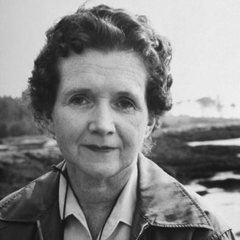
Environmental Concerns
Rachel Carson – begins study of ecology – relationship between living things and their environment
Population growth is hurting the environment
Pollution, Pesticides, harmful chemicals

Slide 24
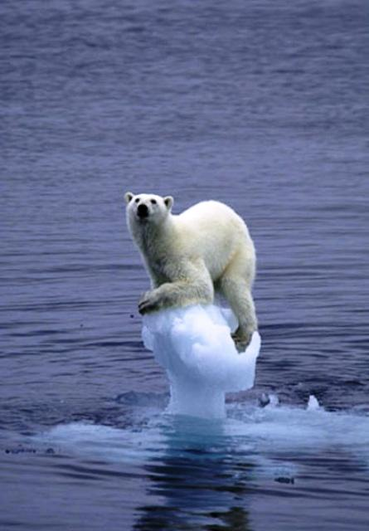
Environmental Issues
Global warming
Release of gases
Aerosol cans, refrigerators, etc
Destroys ozone layer
Creates GREENHOUSE effect
Kyoto Protocol
Agreement to reduce emissions signed by 150 nations (not U.S.)

Slide 25
Warren Court
Expansion of personal freedom
Free speech and assembly
Press (NY Times V. Sullivan)
Interracial Marriage (Loving v. VA)
Accused (Gideon, Miranda,..)
Contraception (Griswold)
Abortion (Roe)

Slide 26
Tough Year 1968
Tet
MLK Assassination/Riots
Bobby Kennedy
DNC Riots
Law and order gone

Slide 27
60’ take away
Entrance of minorities into mainstream
Law and order and traditional values threatened

Slide 28
Politics 50’s – 70’s
Liberals and Conservatives

Slide 29
22 Amendement
In 1952 the Twenty-second Amendment prohibited a president from seeking a third term

Slide 30
Conservativism
Less Regulations
Religious and traditional views
Small size and scope of government

Slide 31
Liberalism
Government as good force to help people
open to new behavior or opinions and willing to discard traditional values.

Slide 32
Election of 1952
Eisenhower
above political squabbling
His domestic program was called “dynamic conservatism”
He cut spending and programs
Including national defense
end wage and price controls.
He cut taxes for corporations and the wealthy

Slide 34
1956

Slide 35
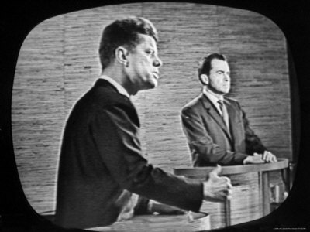
The Election of 1960
V.P. Richard Nixon
stand up to the Soviets
John F. Kennedy

Slide 37
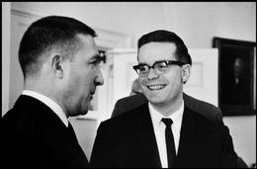
Camelot

Slide 38
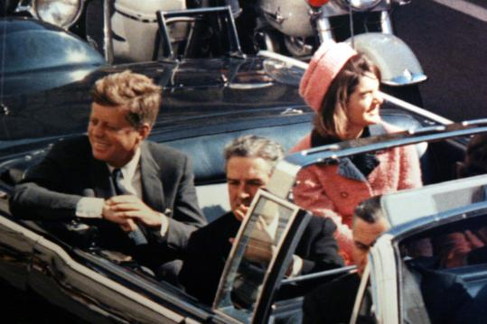
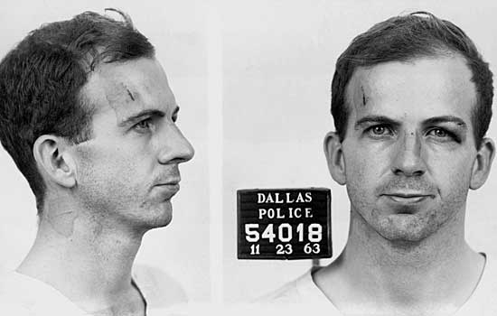
Lyndon Baines Johnson
1963 Kennedy was assassinated
Johnson continued much of Kennedy’s foreign policy

Slide 39
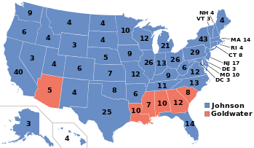
1964 Election
Goldwater looses but wins
Wins 5 southern states

Slide 40
Johnson
Great Society
Vietnam Escalation
Chooses not to run in 68

Slide 41
Conservative Concerns
Traditional family values fading
Sexual revolution
Divorce rate sky rockets
Birth rate declined
Title IX
Women in workforce backlash
Equal rights amendment

Slide 42
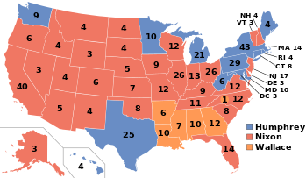
1968 Election
Nixon loser to winner
Rights revolution has gone too far

Slide 43
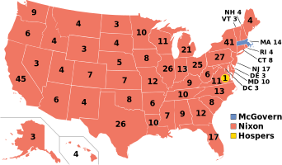
1972 election
Watergate
Nixon Cheated CREEPS (Comt Re-elct Pres)
HUSH money
Hit List
Abuse of power

Slide 44
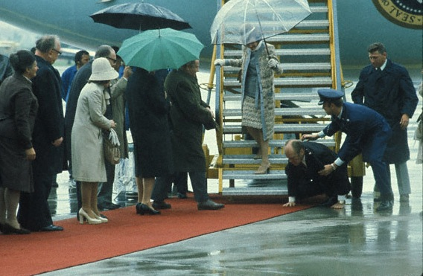
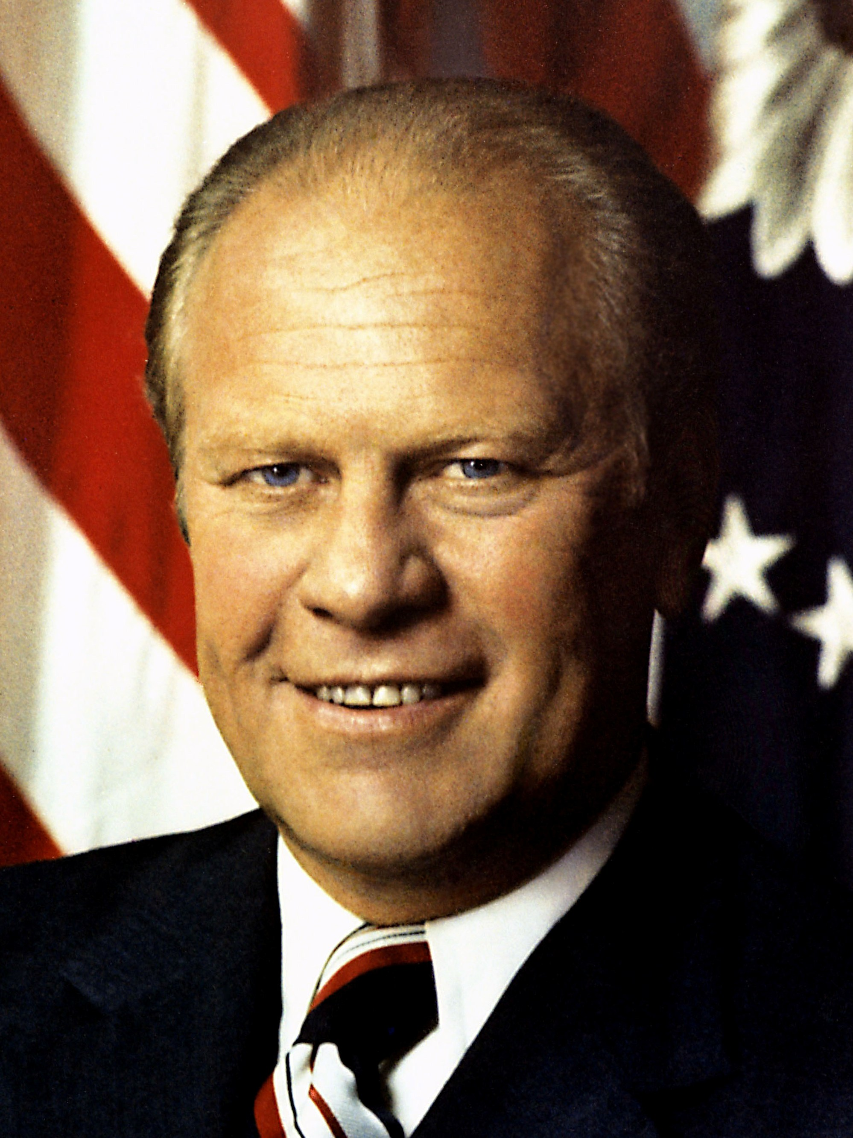
Gerald Ford
Non- nat’l elect president (Speaker of House)
Pardons Nixon

Slide 45
1976 Election

Slide 46
Jimmy Cater
Washington Outsider
Iran Hostages
Economic Crisis
Gas shortage
Inflation
High Mortgage Rates
Camp David Accords

Slide 47
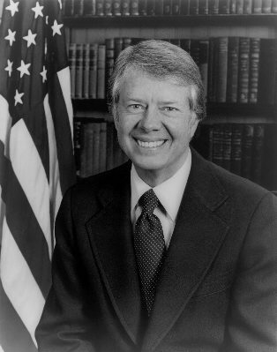
1976-1980 Jimmy Carter (d)
Energy Crisis
Economic Crisis
Gas shortage
Inflation
High Mortgage Rates
Hostage Crisis
Camp David accords
Peace agreement w/ Israel and Egypt

Slide 48
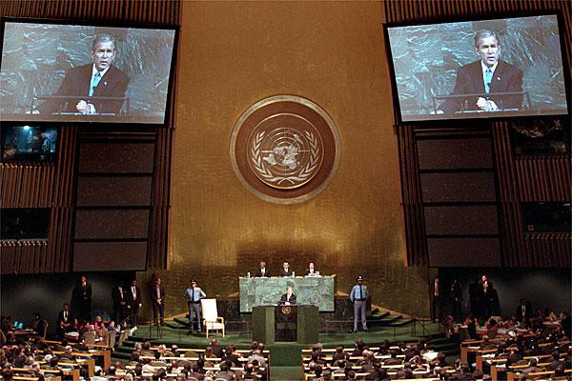
International Organizations
United Nations - peace
NAFTA – trade
WTO - trade
European Union

Slide 49
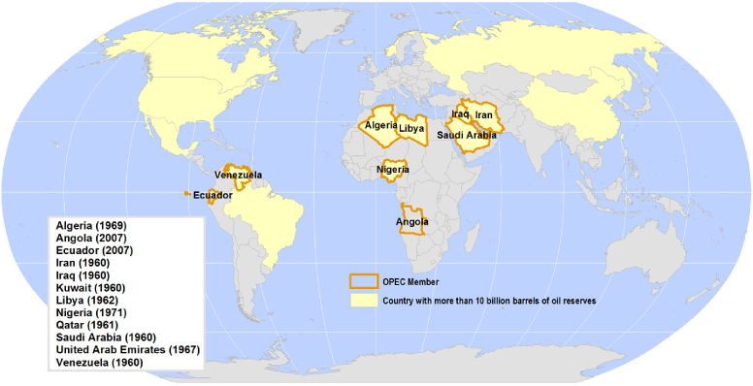
International Trade and Business
Large global corporations
Nations operating inside other nations
International Organizations
OPEC (Organization of Petroleum Exporting Countries)
Causes major problems among trading nations

Slide 50
1980

Slide 51
1984

Slide 52
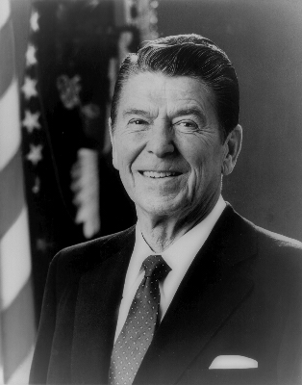
1980 –1988 Ronald Reagan (r)
Conservative Coalition
Moral Majority-evangelical Christianity Standards of right and wrong
Reaganomics-trickle down-supply side
Iran-Contra Affair
Star Wars SDI
End of Cold War “tear down this wall”
Challenger disaster

Slide 53
1988

Slide 54
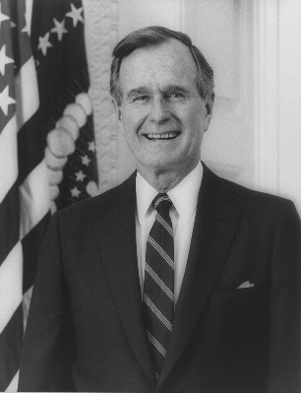
1988 – 1992 George H. Bush (r)
“Read my lips no new taxes”
Gulf War
Liberation of Kuwait
Reagan’s VP

Slide 55
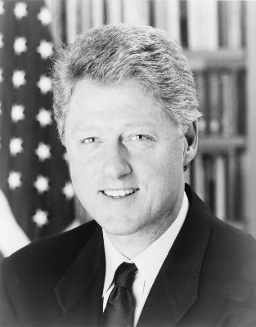
1992-2000 Bill Clinton (d)
Sent troops to Bosnia
Impeached by the House not by Senate
Perjury obstruction of justice
NAFTA (north atlantic free trade agreement)
Hillary and Health care reform

Slide 56
1992

Slide 57
2000-2008 George W. Bush (r)
War on Terror
Bush Doctrine
Hunt down terrorist and those who harbor
Axis of Evil
North Korea, Iran, Iraq
War in Iraq and Afghanistan

Slide 58
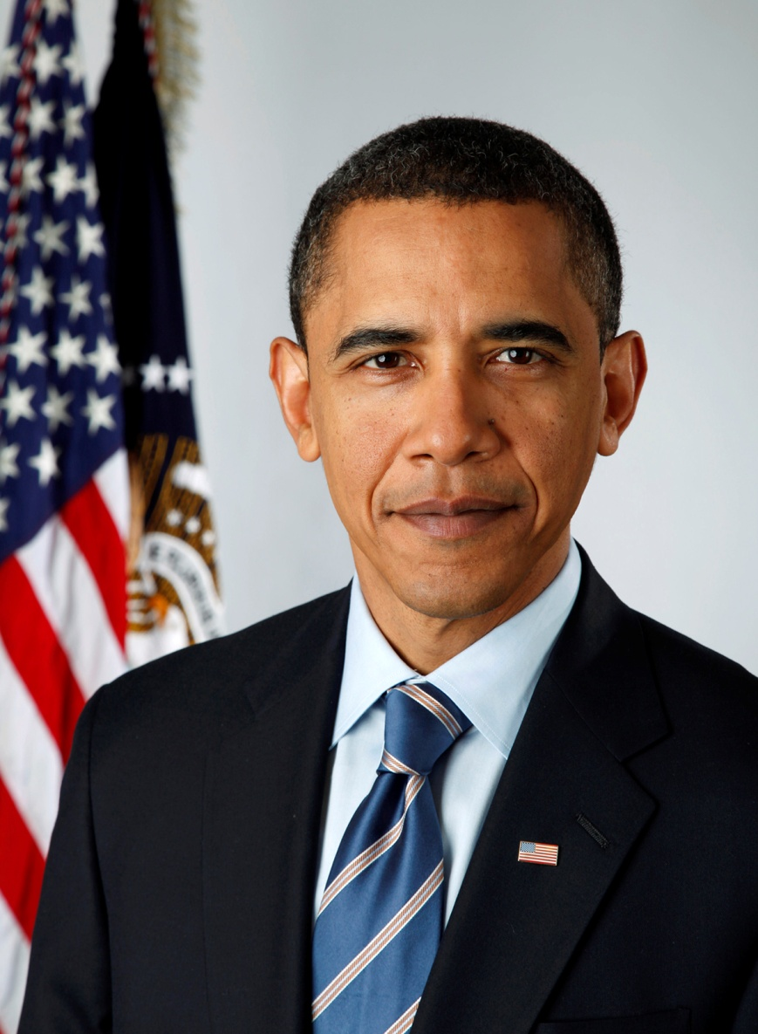
2008-(present) Barrak Obama (d)
First African American President
Recession
unemployment
Obamacare

Slide 59
Decades
60’s
Bay of Pigs
Missile Crisis
Assasination of Kennedy
Civil Rights Acts
Troops go to Vietnam
Thurgood Marshall first black SC justice
Martin Luther King
Walk on the moon
Hippie era
70’s
Begin withdrawal from Vietnam
Watergate
Women's Rights
Roe v Wade
Disco Era
Gas Prices go up
Earth Day
Three Mile island explosion
Middle East Problems

Slide 60
Modern Transportation
Faster more reliable
Communication is instantaneous
Mass media power
All increase trade and global interconnection

Slide 61
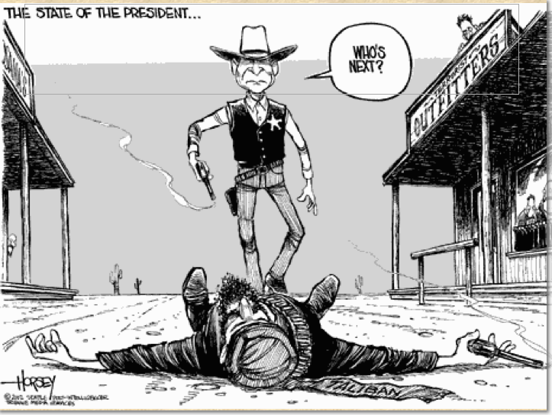
Bush Doctrine
State-sponsored terrorism – training and arming extremist to carry out attacks.
“Hunt down terrorist and those who harbor them”
Patriot Act
Allows secret searches
Wiretap suspects
Email, voice mail, library records
Department of Homeland Security
TSA

Slide 62
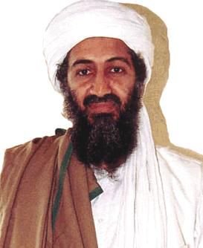
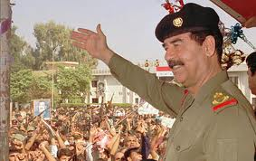
Terrorism
Al Qaeda –Osama Bin Laden
Hamas in Israel
Hezbollah in Lebanon
Suicide bombers-Israel and Iraq

Slide 63
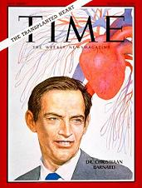
Advances in Medicine
Heart Transplants (Dr. Chris Barnard)
First in Cape Town South Africa.
New Vaccines
Influenza
Small Pox
New diseases
HIV/Aids
Cancer
Brain research

Slide 64
Communications Explosion
Internet
The World Wide Web developed in 1990’s
Satellites
Cable TV
Cell Phones
Computers
IBM makes 1st in 1948 (IBM 1401)

