Slide 1
1820-1848
Nationalism Pride to Sectional Disaster

Slide 2
Nationalism (n.) – loyalty or devotion to a nation, especially an attitude, feeling, or belief characterized by a sense of national consciousness; an exaltation of one nation above all others, and an emphasis on loyalty to and promotion of national culture and interests as opposed to subordinate areas or other nations.
Sectionalism (n.) – devotion to one’s region; holding the interests of a region over the interests of the whole nation.

Slide 3
Post War of 1812
Nationalism was reflected in the post-War period through increased national pride, an emphasis on national issues, an increase in the power and scope of the national gov’t, and a growing sense of American identity.
Ways nationalism was present after the War of 1812?
  Patriotism
  Political
  Economic
  Cultural

Slide 4
Economic Nationalism
  The War of 1812 illustrated problems with roads and transportation in the west
  1807-1814 – years of Embargo and blockades had enabled American manufacturing to develop.
  1815 – cheap British goods flood the American market
  Henry Clay calls for an “American System”

Slide 5
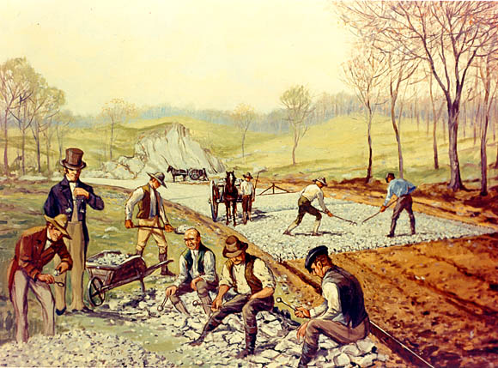
“American System”
Proposal | Action
Protective Tariff | Adopted 1816; 20-25%
National Bank | BUS Rechartered in 1816
Road / Canal Building | National Road (aka Cumberland Road) construction begins Bonus Bill (1817) vetoed by Madison; ”internal improvements” seen as unconstitutional States must undertake their own projects: Erie Canal (1817/1825); Ohio & Erie Canal (1832)

Slide 6
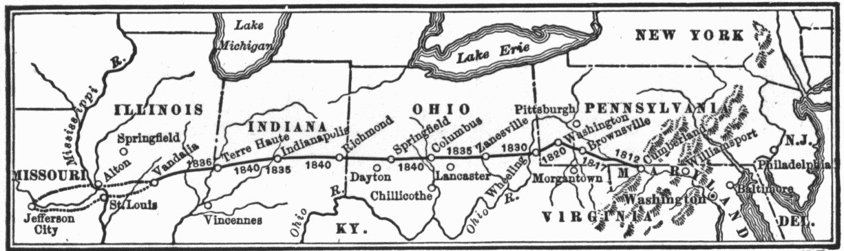
Cumberland Road

Slide 7
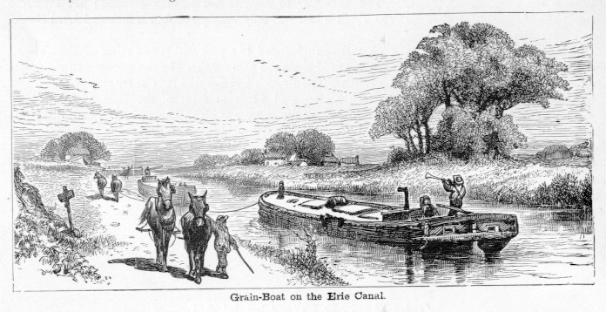
Impact of the Erie Canal
  Cost of shipping 1 ton of grain from Buffalo to NYC drops $100 to $5; time from 20 days to 6.
  Food prices drop as a result; potato prices drop 50% (hurts New England farmers, who move west).

Slide 8
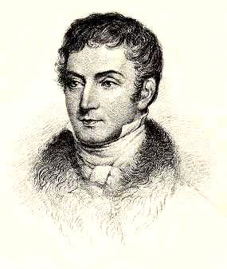
Cultural Nationalism
Literature
  Webster’s New American Dictionary
  North American Review (1815)

Slide 9
Political Nationalism
Death of the Federalist Party
  “Era of Good Feelings” / One party rule emerges
  James Madison elected 1816 / 1820
    Makes “tour” of the nation on 1817
John Marshall & Judicial Nationalism
  Decisions increase the power of the federal gov’t and expand its authority

Slide 10
Judicial Nationalism Marshall Court
Fletcher v. Peck | States cannot override contracts
Marbury v. Madison | Judicial Review
McCulloch v. Maryland | National bank is constitutional. Upholds “loose construction”
Dartmouth v. Woodward | Upholds contracts against state actions
Cohens v. Virginia | Judicial review applies to state court decisions as well…
Gibbons v. Ogden | Only federal gov’t can regulate interstate trade

Slide 11
Federal Governments Power
Gibbons v. Ogden-1824
  federal gov’t regulates interstate commerce.
McCulloch v. Maryland-1819
  state can’t tax federal bank.
    Both cases ruled on by Chief Justice John Marshall (nationalist).

Slide 12
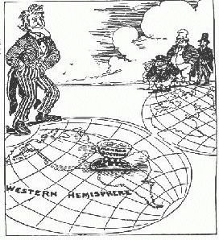
Diplomatic Nationalism
Monroe Doctrine
  Warns Europe to stay out of Western Hemisphere
Transcontinental Treaty
  Spain cedes all of Florida
    Andy Jackson first governor

Slide 13
Geographic Nationalism

Slide 14
Post-war treaties…
Re-establish trade with the British
  Flooded market with cheap stuff
1817 Rush-Bagot Agreement
  Ends Naval Armaments on Great Lakes
Convention of 1818 line
  49th parallel
Joint occupation of Oregon Territory
  We will win that one later
Adams-Onis Treaty, 1819
  Whats our whats Spains

Slide 15
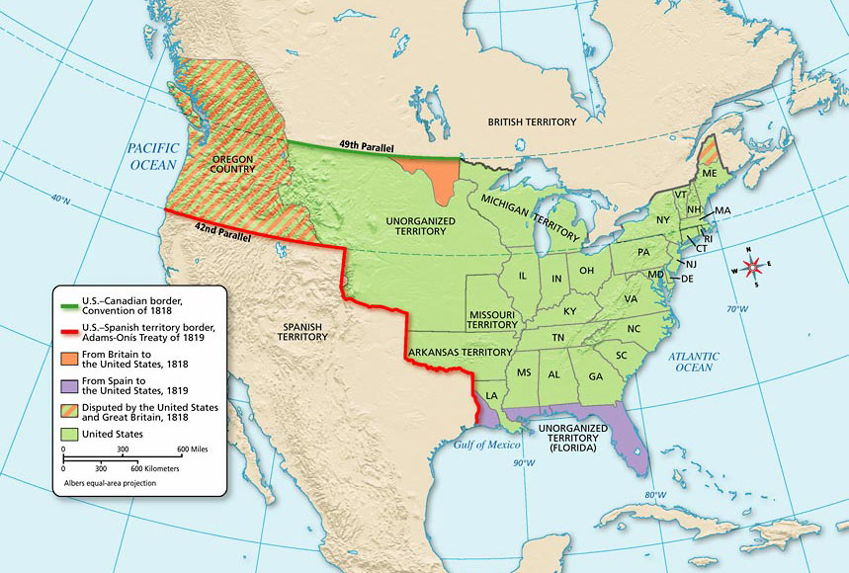

Slide 16
Westward Expansion
Factors
  Push-forced to leave because of population explosion, competition for jobs, and resources.
  Pull-attracted by free land and opportunities for growth.

Slide 17
The Missouri Question
Background:
  1818 there were 22 states
    11 slaveholding
    11 free
  1819 Missouri applied for statehood as a slaveholding state
  Congress debated…
    Tallmadge Amendment
      Gradual elimination of slavery in Missouri
  1820 the debate continues…
    Henry Clay offers a compromise

Slide 18
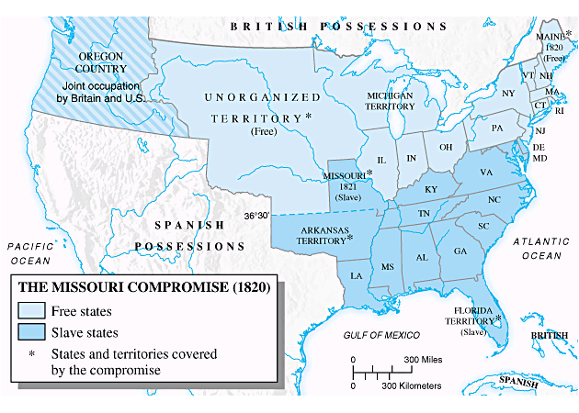
Missouri Compromise of 1820
Proposed by Henry Clay
Missouri admitted as a slave state
Maine admitted as a free state
36º 30’ line is established
This pushes the issue of slavery back to the state level…
2
3
1

Slide 19
And be it further enacted. That in all that territory ceded by France to the United States, under the name of Louisiana, which lies north of thirty-six degrees and thirty minutes north latitude, not included within the limits of the state, contemplated by this act, slavery and involuntary servitude, otherwise than in the punishment of crimes, whereof the parties shall have been duly convicted, shall be, and is hereby, forever prohibited: Provided always, That any person escaping into the same, from whom labour or service is lawfully claimed, in any state or territory of the United States, such fugitive may be lawfully reclaimed and conveyed to the person claiming his or her labour or service as aforesaid
.

Slide 20
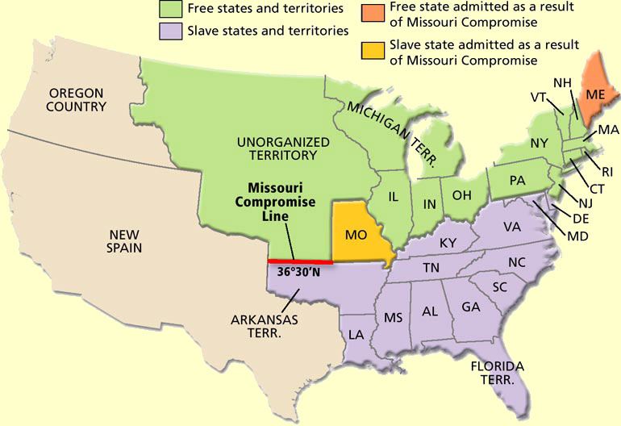

Slide 21
Andrew Jackson’s Big Issues
Domestic
  Politics
  Native Americans
  States Rights and the Tariff
  BUS

Slide 22
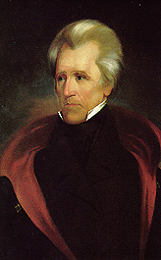
Politics
Lost 1824 Election-”Corrupt Bargain”
  Henry Clay dropped out of race to get support for American System.
  John Q. Adams wins
1828 Campaign-appeal to common folk: “Old Hickory”
  Practiced Spoils system or patronage;
    reward jobs to friends.

Slide 23
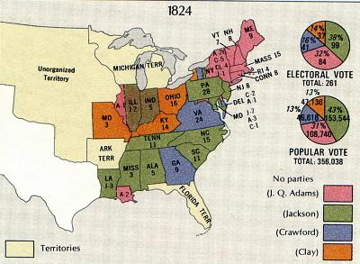
Election of 1824
-no winner of electoral college
-John Q. Adams chosen over Jackson as President
-Called corrupt bargain because Jackson had most votes
-Jackson’s supporters formed Democratic Party and opposed Adams’ policies

Slide 24
Native Americans
Indian Removal Act 1830
  Assimilation failed
    trying to blend Indians into Whitey’s society.
  Displacement wins
    Remove them from the land
    Trail of tears
Worcester v. Georgia 1832
  Court ruled in favor of the Cherokee
    Jackson ignores the ruling

Slide 25
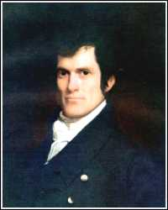
State’s Rights and the Tariff
Brits angry about War of 1812-flood US with cheap goods.
  Congress passes tariff and increased twice.
  HURTS SOUTHERNERS
John C. Calhoun of South Carolina called it the Tariff of Abominations 1828.
  Calhoun devised nullification theory-void federal law.

Slide 26
South Responds
SC rebels-
  state’s rights to nullify
  threaten to secede.
Jackson threatens to hang Calhoun and send in Army.
Henry Clay compromises-tariff lessens over 10 years.

Slide 27
The BUS
Battled Bank of United States (BUS)
  Created State banks (Pet Banks)
    Wildcat banks printed their own money
    Trying to take $ out of BUS
  Jackson makes Gold and Silver only acceptable “specie” for land payment.
    Paper money is worthless

Slide 28
Jackson’s Legacy
Strong Presidents

Slide 29
Martin Van Buren, Harrison and Tyler
Martin Van Buren
  inherits bad economy.
  Panic of 1837-banks shut down; recession
William Harrison
  dies 30 days into office. “Tippecanoe and Tyler too.” –Campaign slogan.
Tyler
  takes over “His accidency”. Only on ballot to get southern votes.

Slide 30
Revival and Reform
“no country in the world where the Christian religion retains a greater influence over the souls of men than in America”
Alex de Tocqueville
Reason is dead
Heart over Head

Slide 31
The Great Revival
Begins in New England
Frontier “Camp Meetings”
Burnt over district – Western New York
Baptist
  Simple structure
Methodist (largest in 1840)
  Circuit rider preachers
Mormons
  Joe Smith
  Brigham Young
  Latter Migrate to Utah

Slide 32
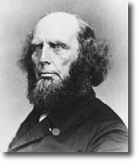
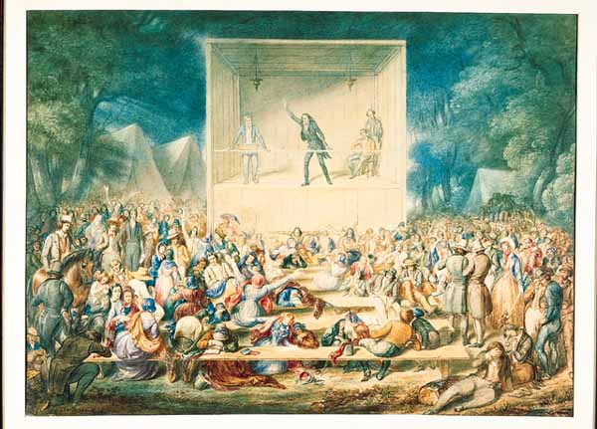
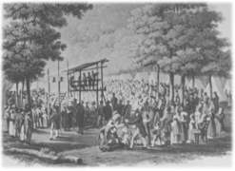
Second Great Awakening
Charles G. Finney
Theodore Weld
Lyman Beecher
Barton Stone
Peter Cartwright
Camp Meetings
Sparks Reform
Burned-over District

Slide 33
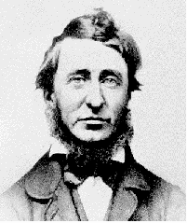
Transcendentalism
-science and reason do not “cut it”
Puritan morals and spiritualism combine with reason is dead

Slide 34
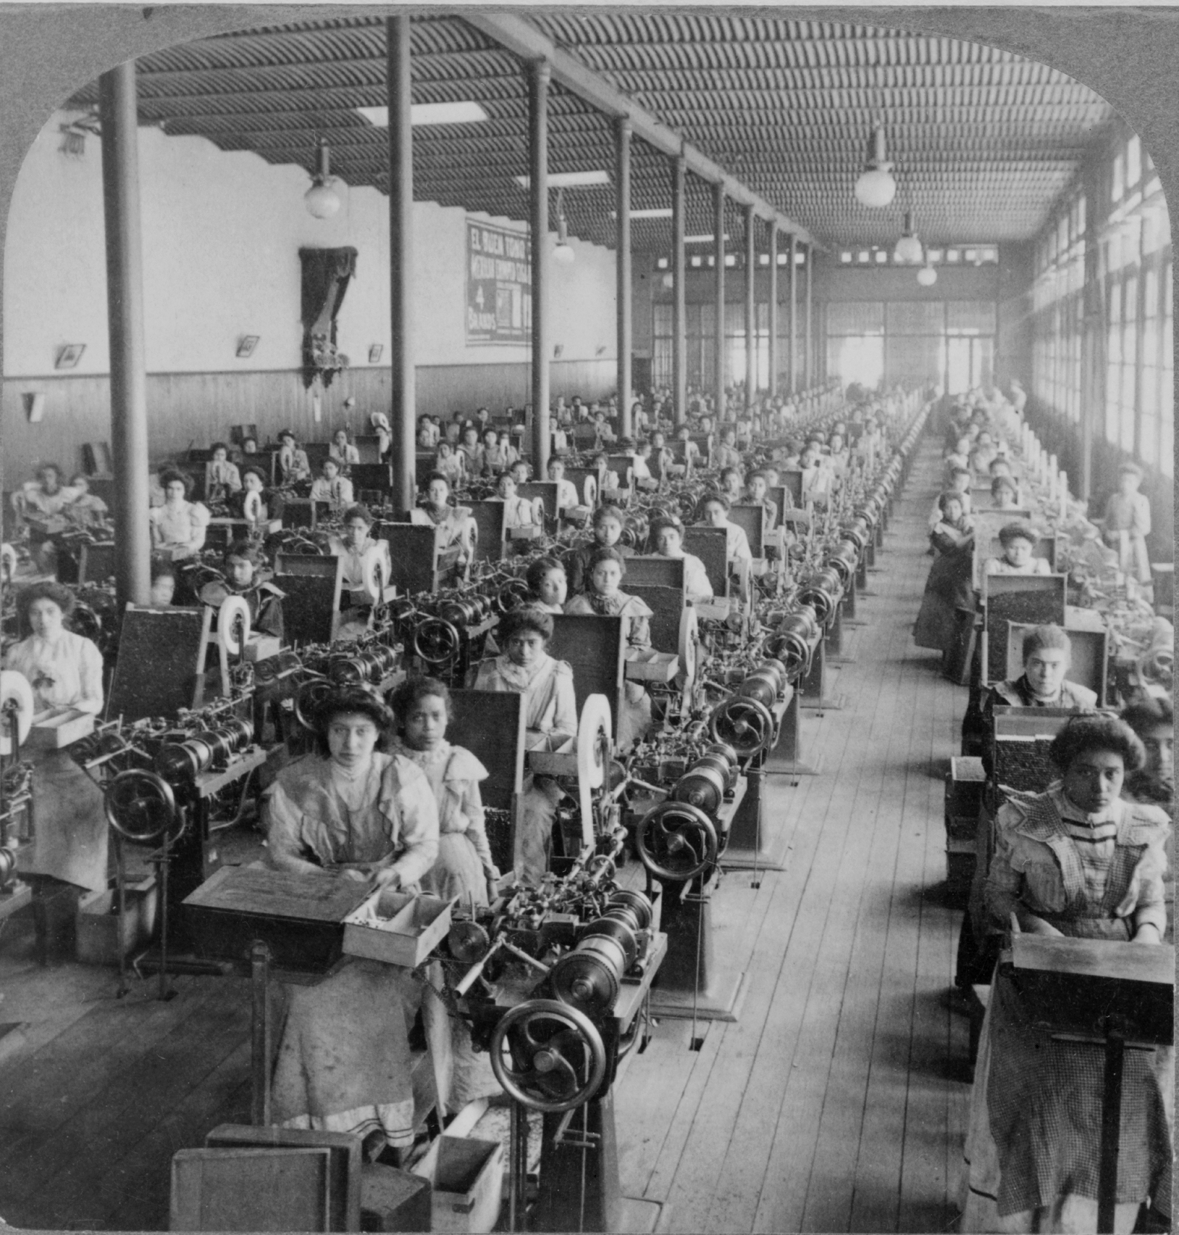
Transcendentalism
-belief in a simple lifestyle
-nationalism and big business are killing the individual
-nonconformist

Slide 35
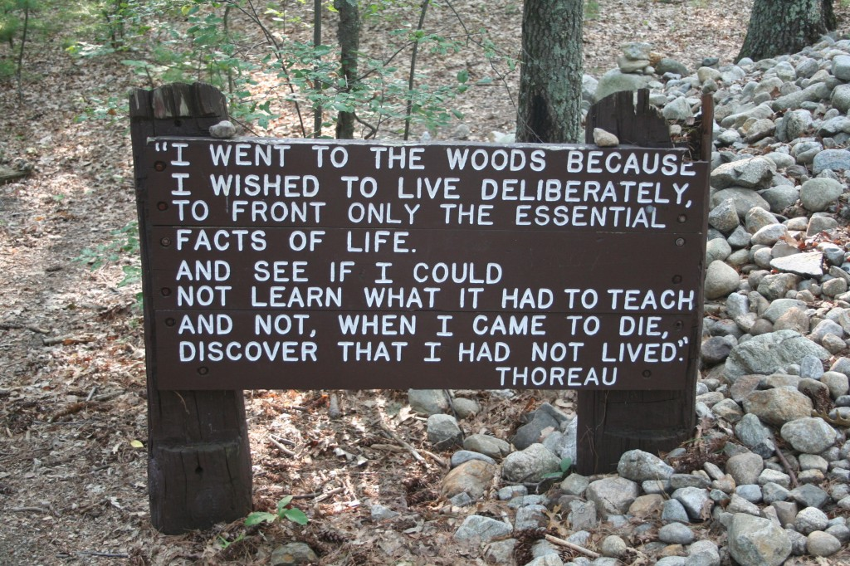
Transcendentalism
-Ralph Waldo Emerson
-”Self-Reliance”
-Henry David Thoreau
-”Civil Disobedience”

Slide 36
-Utopian Communities
-communal societies based on everyone working together
-most did not work well
-New Harmony
- Brook Farm
- Shakers
- Mormons
-Oneida

Slide 37
Education
-one room schools
-few educated beyond age 10
-Horace Mann
advocated public schools for everyone
“for every rank and condition”
-Noah Webster
development of an American dictionary and readers

Slide 38
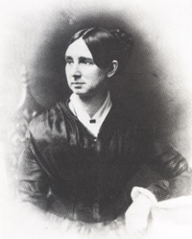
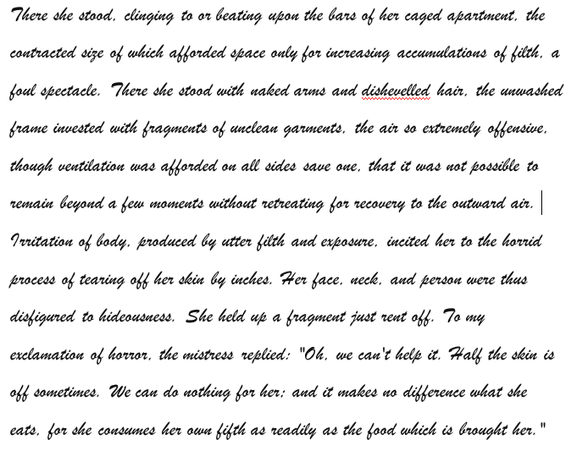
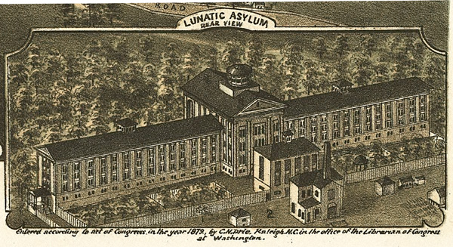
Dorothea Dix

Slide 39
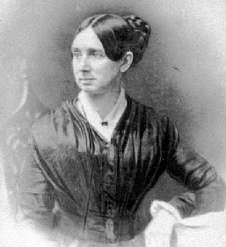
Institution Reform
-Dorothea Dix
- help for the mentally ill
-helped to start several mental hospitals
-prison reform
-meant to rehabilitate

Slide 40
American Writers
-James Fenimore Cooper
“Last of the Mohicans”
-Nathaniel Hawthorne
“Scarlet Letter”
-Washington Irving
“Sleepy Hollow”
-Herman Melville
“Moby Dick”

Slide 41
American Writers
-Edgar Allan Poe
“Raven”
-Emily Dickinson
reclusive poet
American Art
-Hudson River School
-landscape painters

Slide 42
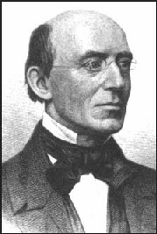
Abolitionists
-those who opposed slavery
-William Lloyd Garrison
“The Liberator”
-David Walker
freedom by force
-Frederick Douglas
“North Star”

Slide 43
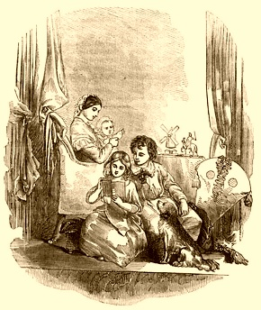
Women in Society
-Republican Motherhood
civic duty and role at home
pass on republican virtues
Increased educational ops
-Cult of Domesticity
husband, home, heaven
-could not vote in most places
-could not own property or keep wages if husband lived

Slide 45
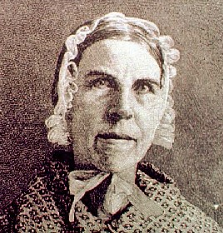
Reformers
-Abolitionists / Suffrage
Grimke sisters
Lucretia Mott
Elizabeth Stanton
Susan B. Anthony
Sojourner Truth
-Temperance
move to ban alcohol

Slide 46
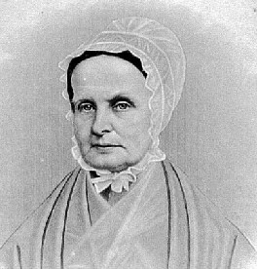
Women’s Reforms
-Abolitionists / Suffrage
Grimke sisters
Lucretia Mott
Elizabeth Stanton
Susan B. Anthony
Sojourner Truth
-Temperance
move to ban alcohol

Slide 47
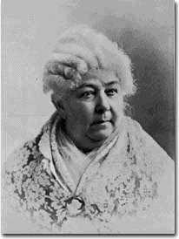
Women’s Reforms
-Abolitionists / Suffrage
Grimke sisters
Lucretia Mott
Elizabeth Stanton
Susan B. Anthony
Sojourner Truth
-Temperance
move to ban alcohol

Slide 48
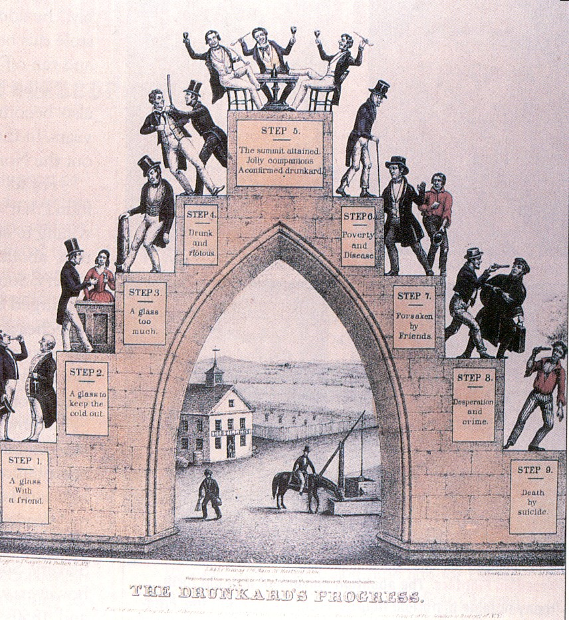
Women’s Reforms
-Abolitionists / Suffrage
Grimke sisters
Lucretia Mott
Elizabeth Stanton
Susan B. Anthony
Sojourner Truth
-Temperance
move to ban alcohol

Slide 49
The nine steps of
The Drunkard's Progress,
Step 1: A glass with a friend.
Step 2: A glass to keep the cold out.
Step 3: A glass too much.
Step 4: Drunk and riotous.
Step 5: The summit attained. Jolly companions. A confirmed drunkard.
Step 6: Poverty and disease.
Step 7: Forsaken by friends.
Step 8: Desperation and crime.
Step 9: Death by suicide.
1846 by Nathaniel Currier.

Slide 50
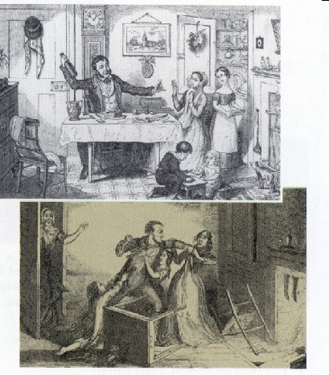
Women’s Reforms
-Abolitionists / Suffrage
Grimke sisters
Lucretia Mott
Elizabeth Stanton
Susan B. Anthony
Sojourner Truth
-Temperance
move to ban alcohol

Slide 51
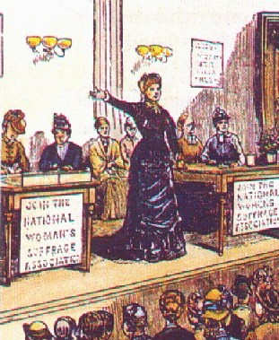
Women’s Movement
-women saw increased opportunities in reform movements
-Seneca Falls Convention, 1848
“Declaration of Sentiments”

Slide 52
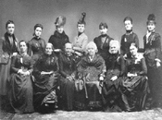
Women’s Movement
-women saw increased opportunities in reform movements
-Seneca Falls Convention, 1848
“Declaration of Sentiments”

Slide 53
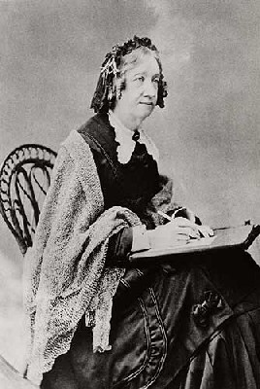
Reforms
-Women’s Education
Catherine Beecher
Oberlin College
-Health Reform
Elizabeth Blackwell
Amelia Bloomer

